Slide 1
CHAPTERS 14-15
Moral Hazard and Adverse Selection

Slide 2
Definition of Moral Hazard
Moral hazard (principal-agent) problems arise whenever there is a separation of ownership and control.
The principal delegates decision-making authority to the agent
Moral hazard refers to the risk that the agent will not act in the best interests of the principal.
Moral hazard exists because it is not possible for the principal to monitor all actions taken by the agent.
Notes:
In principal-agent theory, the principal is typically the "owner" who has delegated decision-making authority to the "agent". The principal has a property right in a resource that is managed by the agent, and depending upon the agent’s actions, the value of that property right will certainly be affected (positively or negatively) by the actions taken by the agent.
The separation of ownership and control would not be a problem if one could costlessly write and enforce contracts specifying exactly what agents are expected to do under all possible contingencies.
However, it may not be possible (or for that matter, desirable) for the principal to monitor all actions of the agent; thus, considerable discretion must be given to the agent.

Slide 3
Examples of principal-agent relationships
In corporate governance, the owner-manager relationship.
In corporate finance, the creditor-owner relationship.
In insurance, the insurer-policyholder relationship.
In civil litigation, the client-lawyer relationship.
In a broader "stakeholder" context, the society-firm relationship.
Notes:
Owner-manager relationship: Your firm’s board of directors hires a new CEO. Does the CEO maximize share value, or pursue other objectives; e.g., maximization of growth or perquisites, donating money to his/her favorite charity or political party, etc.
Creditor-owner relationship: Because of limited liability, owners face limited downside risk while retaining exposure to upside potential; this can create incentives for firms to shift risk onto creditors and in some cases also "underinvest"; i.e., forego positive NPV projects.
Insurer-policyholder relationship: You purchase homeowners insurance. If you invest in safety; e.g., install fire alarms, retrofit your home to minimize storm-related damage, etc., then you bear the cost but the insurer reaps the benefit. Therefore, you may be tempted to "under-invest" in safety.
Client-Lawyer relationship: Suppose you are injured in a car crash. You employ a lawyer to sue other driver. You are the principal; the lawyer is your agent. Does your lawyer really act in your best interest?
Society-firm relationship: Here the concern is primarily with so-called negative externalities; e.g., what to do about a firm that pollutes the environment. Society uses law and regulation as methods for trying to mitigate such costs. Furthermore, an interesting experiment pertains to the assignment of tradeable property rights to pollution; i.e., the so-called "cap and trade" system. Under cap and trade, a central authority (typically a government or international body) sets a limit or cap on the amount of a pollutant that can be emitted. Firms are issued emission permits and are required to hold an equivalent number of allowances (or credits) which represent the right to emit a specific amount. The total amount of allowances and credits cannot exceed the cap, limiting total emissions to that level. Companies that need to increase their emission allowance must buy credits from those who pollute less. In effect, the buyer is paying a charge for polluting, while the seller is being rewarded for having reduced emissions by more than was needed. Thus, in theory, those that can easily reduce emissions most cheaply will do so, achieving the pollution reduction at the lowest possible cost to society.

Slide 4
Principal-Agent Problems and Moral Hazard
General solution to principal-agent problems
Design contracts so that they are incentive compatible.
Incentive compatible contracts scale agent compensation to the benefit received by the principal; examples include:
Managerial compensation typically includes bonuses related to profit or share price (in addition to salary).
Policyholders are not offered full (complete) insurance coverage; consequently, they are exposed to a partial loss and this reinforces incentives to prevent/mitigate loss.
Lawyers often receive contingent fees related to size of award.
Notes:
Incentive compatible contracts are contracts that are effective in aligning incentives between principals and agents. The key feature is that there is some form of risk sharing; since there is moral hazard, it is usually optimal for principals and agents to share risk. This way, everyone has skin in the game.

Slide 5
Insurance and Moral Hazard
Notes:
Suppose that a consumer with initial wealth W₀ faces a risk of loss L with probability p. The probability of loss is a function of the level of safety (s) chosen; i.e., p = p(s), where p'(s)<0. The cost of safety is c(s), where c'(s)>0. When deciding to invest in safety, the consumer will select a level of safety that maximizes her expected utility of wealth. Assume that the consumer is risk neutral. Then her objective is to select the level of safety s such that maximizes her expected wealth.
Essentially, E(W) is concave in s, which means that there exists a value of s at which E(W) is maximized. This is why we compute the first derivative, set it equal to zero, and then solve for marginal cost and benefit as in equation (3) above.

Slide 6
Insurance and Moral Hazard
Notes:
Note that if a = 1, then E(W) = W - c(s) - P. Differentiating expected utility with respect to s, we find that at the optimum, marginal cost must equal zero; i.e., -c’(s*) = 0. In order to have marginal cost of zero, it must be the case that s* = 0.
Here we do not have incentive compatibility between the insurer and the policyholder, because there is moral hazard!

Slide 7
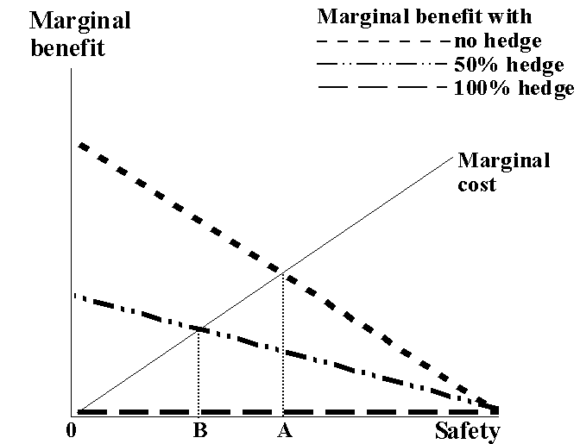
Insurance and Moral Hazard

Slide 8
Insurance and Moral Hazard
Notes:
Note that if a = 1, E(W) = W - c(s) – P(s), which implies that c’(s*) = P’(s*). Since marginal cost is positive in this case, so is s*. Therefore the optimal level of safety will be higher than it was when premiums were not a function of the level of safety.
Examples of safety "investment"
Auto insurance – anti-lock brakes, extra airbags, defensive driving classes
Fire insurance – installation of sprinkler systems and smoke detectors.
Another way to make the premium a function of the level of safety is to use experience rating. Experience rated premiums are calculated with reference to the loss experience of prior periods. If I know my premiums in the future are to be experience rated, and I anticipate buying insurance in the future, then I will encouraged to take care ("invest" in safety) even though the insurer will pay for losses.
Auto liability insurance is experience rated – it is common knowledge that if one produces a safe driving record, this will be reflected in the form of lower future insurance premiums.
Most other forms of liability insurance are also experience rated; e.g., product liability, workplace safety, etc.
By making the premium to be paid a function of the level of safety chosen, the insurer has designed an incentive-compatible contract!

Slide 9
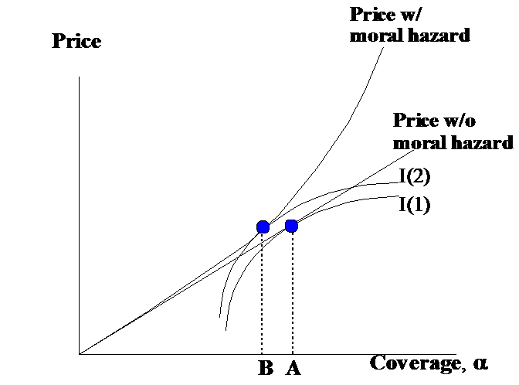
Insurance and Moral Hazard
Notes:
This figure illustrates the fact that whenever risk is shared, there is moral hazard; thus moral hazard limits risk transfer. This is why policyholders are rarely if ever offered full coverage contracts, and why corporate managers’ compensation contracts require sharing corporate risk, even though they are at a disadvantage vis-à-vis owners in terms of the cost of risk bearing. Basically, in any principal-agent relationship, it’s important that the agent have some skin in the game!
Note that expected utility increases as we move in the southeast direction in the graph – we are getting higher level of coverage at lower prices.
Even with experience rating, there will be residual moral hazard. This figure demonstrates that in the presence of moral hazard, the level of insurance is lower; i.e., the optimal contract involves a higher degree of risk sharing than would be the case in the absence of moral hazard.
In this graph, the direction in which there is the highest expected utility is in the southeast corner, since this provides maximum insurance at a minimum price.
The key point of this figure is that moral hazard limits insurability. It will never be optimal to fully insure risk when moral hazard is present. This has implications reaching far beyond insurance markets. For example, the optimal wage bargain will always involve risk sharing. Owners and creditors of corporations share risk due to limited liability, etc.

Slide 10
Insurance and Moral Hazard
Risk transfer creates moral hazard
Contractual and pricing strategies for mitigating moral hazard:
Contractual strategy: Risk sharing (e.g., “partial” instead of “full” insurance coverage)
Pricing strategy: Experience rating (a form of "ex post" settling up)
Notes:
In insurance, you know going in that if you take actions now which increase claims later, then you will eventually have to pay later for this behavior. On the other hand, you also know that if you take actions now which decrease claims later, then you will be rewarded.
In executive compensation, compensation contracts typically include bonuses related to profit or share price in addition to salary. There is also a firing threat. Thus we have "partial" insurance; i.e., risk is shared between the owner and the manager. The "ex post" settling up mechanism comes in the form of a firing threat that is possibly coupled with some other economic loss; e.g., the revocation of vesting rights for deferred compensation. Often, an executive firing can cause permanent loss of human capital value; she knows beforehand that there may be dire consequences associated with screwing up badly, so this will presumably temper ex ante behavior. This is an important reason why many high level executive positions include some form of golden parachute; basically, this form of compensation is designed to encourage executives to be willing to make bold decisions, even if they come at the expense of becoming effectively retired after the fact.

Slide 11
Class Problem 14.1 (Incentive Compensation)
Currently the CEO receives a fixed salary of $500,000. This salary represents her “reservation” salary; if the utility value of $500,000 for certain is breached, then she will take a job elsewhere. The Board of Directors is concerned that she may be just “going through the motions” and would work harder if she were paid a bonus based upon the firm’s profits.
The CEO’s utility function is U = W^{0.5}, where W comprises initial wealth (W₀ = $1,000,000), salary (S), bonus (B), and cost of effort (C = $50,000, which represents the opportunity cost of hard work for the CEO); thus, W = W₀ + S + B – C. C is only incurred by the CEO if she works hard. The firm’s owners are risk neutral, so they are interested in maximizing the expected value of profit after taking the CEO’s compensation into account.

Slide 12
Class Problem 14.1 (Incentive Compensation)
Under the current compensation scheme, is the Board correct in its assessment of the effort of the CEO? Why or why not?
Will the Board's new compensation scheme have its intended effect, i.e., will the CEO work hard?
What is the minimum level of bonus for the CEO in order for the Board's new compensation scheme to have its intended effect?
Suppose it turns out that the CEO values her cost of effort at $200,000 instead of $50,000. If this were the case, would the Board's new compensation scheme have its intended effect? If not, what is the minimum level of bonus required in order to incentivize the CEO to work hard?
Suppose the CEO values her cost of effort at $500,000. What is the minimum level of bonus in this case? Should you pay this bonus?

Slide 13
Class Problem 14.1 (Incentive Compensation)

Slide 14
Limited Liability and the Creditor-Owner Relationship
Assume a single period – the firm is formed at t=0, and cash flows are realized at t=1.
Let V(F), D, and E represent the t=1 payoffs on the firm’s assets, its debt, and equity. Assume the firm has promised to repay debtholders $B at t=1. Under unlimited liability, these payoffs can be written:
V(F) = D + E;
E = V(F) - B; and
D = B.
Notes:
Under unlimited liability, debtholders are always paid in full, irrespective of the value of the firm. Therefore debt issued by an unlimited liability entity is theoretically riskless, since any shortfalls at the firm level are guaranteed to be paid by the firm’s owners out of their personal assets.

Slide 15
Limited Liability and the Creditor-Owner Relationship
Notes:
Note that if the value of the firm is lower than the promised repayment, the shareholders not only lose the value of their original investment, but with unlimited liability they are liable (from their personal assets) for all of the debt taken on by the firm. The maximum possible loss for shareholders is the value of their original investment (E(E)), plus B.

Slide 16
Limited Liability and the Creditor-Owner Relationship
Notes:
Note that if the value of the firm is lower than the promised repayment, then the shareholders (owners) exercise their "limited liability" put option by declaring bankruptcy and "putting" the firm’s assets to the debtholders (creditors). Limited liability basically forces creditors to provide insurance to owners. This insurance comes with a price, in the sense that debt which is subject to the risk of default is less valuable than debt which is fully guaranteed. Graphically, the value of the “insurance” is represented by the triangular area represented by –B0B. The gain to owners corresponds to the loss suffered by the creditors.
Since there is risk sharing, there will likely be moral hazard. We’ll discuss next the “asset substitution”, or risk shifting problem, which is an important moral hazard related to credit risk. Another important incentive problem is that firms which are financially struggling also may have incentives to either make bad (negatively valued) investments or forego good investments (aka the “underinvestment” problem). Next, we’ll focus our attention on the asset substitution problem.

Slide 17
The Asset Substitution Problem
Notes:
The asset substitution problem is addressed on pp. 490-493 of the textbook.
Here, the capital cost of $200 will be covered by issuing junior debt. Junior debt is paid only after the senior debt has been paid, but before shares are paid.

Slide 18
The Asset Substitution Problem
Notes:
These tables simply blend the state contingent cash flows from the new project with the existing cash flows.
The implicit assumption here is that the cash flows from existing operations and from project be are statistically independent; this assumption allows us to compute the joint probabilities by simply multiplying .5 by .5.

Slide 19
The Asset Substitution Problem
Notes:
This is the classic asset substitution problem. Shareholders favor project B which offers an equity value of 80 compared with 70 for A. If bondholders anticipate this choice, they would only be willing to pay 135 for the new debt issue even though the face value is 200. Since the capital cost of project B is 200, the amount raised from the debt issue would be insufficient to fund the project.
Does this mean that A will be chosen? Suppose that the firm announces its intention to choose A. Unfortunately, investors buying the new debt issue will rationally assume that if they subscribed $200 for the issue, the shareholders would have an incentive to change their minds and use the $200 to fund project B instead. Thus, investors will still only subscribe 135 for the new bond issue.

Slide 20
The Asset Substitution Problem: Precommit to Hedge Project Risk
Notes:
On page 496, the authors argue that one way around this problem is to precommit to hedge or insure risk. To see how this strategy resolves the asset substitution problem, suppose that the firm could precommit to costlessly hedge the risk in project B; i.e., replace a fair lottery of 20 and 310 with a certain value of 165. One way this could be done would be to engage in some sort of forward contract with a counterparty, where the firm pays the counterparty $145 in the good state and receives $145 from the counterparty in the bad state.
Suppose that one of the most important factor inputs for this firm is energy. Consequently, project B may generate more net profit when oil prices are low, and less when oil prices are high. In this case, a natural counterparty would be an oil producer, who would like to receive cash when oil prices are low but is willing to sacrifice profit when oil prices are high in order to obtain this insurance. Similar stories about counterparties could be told in connection with interest rates, foreign exchange, etc.

Slide 21
The Asset Substitution Problem: Precommit to Hedge Project Risk
Notes:
By hedging project risk, we get rid of the asset substitution problem. The effect of credibly committing (via some form of contract; e.g., indenture provisions in the junior bond issue) to hedging project risk is to make the NPV of selecting project A higher than the NPV for selecting project B; hence project A will be chosen, and creditors will subscribe $200 to the bond issue.

Slide 22
The Asset Substitution Problem: Fund with equity
Notes:
On page 496, the authors argue that another way around this problem is to fund with equity. Here, we assume that half the financing comes from equity, the other half from junior debt.
Here, even though there is a partial default on junior debt, the lower level of equity created a situation where the firm is better off choosing project A.
Note that bond indentures typically have covenants limiting times interest earned and debt-equity ratios for this very reason!

Slide 23
Definition of Adverse Selection
Adverse selection is a “Hidden Information” problem
If there is an informational asymmetry, such that one party to a contract has better information than the other, then the informed party may be inclined to take advantage of the uninformed party.
Adverse selection refers to the risk that this will occur.
Notes:
Another way of thinking about moral hazard is that it is a hidden action, as opposed to hidden information problem. Under moral hazard, you know your counterparty; you’re just not sure what they are likely to do if you don’t monitor them closely.

Slide 24
Examples of adverse selection
The seller of a used car has more information about the car than the potential buyers.
Insurers know less about the true risk characteristics of their policyholders than the policyholders themselves.
When a firm hires a worker, it knows less than the worker does about his abilities.
The manufacturer of a product knows more about product failure rates than the consumer.
Notes:
Adverse selection is often referred to as a "lemons" problem. This is in reference to a very famous paper published in 1970 by Professor George Akerlof, who is an economics professor at UC-Berkeley and was cited along with Joseph Stiglitz (Columbia) and Michael Spence (Stanford) for the 2001 Nobel Prize in Economics. Akerlof analyzed a familiar economic transaction, the buying and selling of a used car. In this market, he noted, the seller has more information than the buyer about the condition of the vehicle. The buyer, consequently, is suspicious of the product and makes inferences about its quality based on limited information. He or she may not be willing to pay as much for the car as it is worth (if in fact it is not a lemon).

Slide 25
Strategies for mitigating adverse selection
Risk Classification
Signaling
Resolving adverse selection through self-selection (contract design innovations)
Notes:
Risk classification
Examples of risk classification in auto insurance include factors such as credit scores (people with lousy credit scores tend to have more accidents), location, type, and use of car, gender of driver (primarily important at younger ages)
Examples of risk classification in health insurance, life insurance, and annuity markets include factors such as health history, current health status as indicated by a medical exam, the use of genetic information (e.g., BRCA gene defect), age (higher morbidity at older ages), whether you smoke or bungie jump, etc.
Signaling is used in various settings:
For example, one solution to the lemons problem in the market for used cars is for the buyer to "signal" by acquiring credible third party certification; e.g., pay for an inspection by Lemon Busters.
Similarly, students "signal" their quality by selecting a high quality university. Here the university plays the role of third party certification.
Product warranties can be used to signal product quality. For example, if a manufacturer is willing or provide a long-term warranty, this may indicate that quality is better than average. On the other hand, this warranty is of limited value if there is some possibility that the firm may fail at some point during the warranty period.
In business, firms may use dividends to signal their profits to others in the stock market, another example of market signaling; also, we can use this theory to explain the role of auditing of company financial records by reputable third party accounting firms, as well as the role of security analysts. If the signals provided by auditors and analysts are credible, then the firm's shares trade at higher prices; essentially because adverse selection costs are mitigated.
In the case of adverse selection, contract design innovations are important in terms of creating incentives for consumers to self select according to their true risk characteristics. This problem will be studied later in tonight’s lecture – it is at the heart of the Rothschild-Stiglitz "separating equilibrium" concept.

Slide 26
Adverse Selection in Insurance
To see how adverse selection can arise in insurance markets, consider the case of automobile insurance.
Assume there are only two states of the world (loss and no loss), and drivers can be grouped into two risk classes: those with a high accident probability (p_{H} = 75%), and those with a low accident probability (p_{L} = 25%). Suppose also that we can correctly identify the low and high risk drivers.
Except for accident risk, drivers are identical in all respects; i.e., W₀ = $125 and L = $100. Thus if there are no transactions costs,
E(W_{L}) = W₀-E(L_{L}) = $125-.25($100) = $100 for low risk drivers, and
E(W_{H}) = W₀ -E(L_{H}) = $125-.75($100) = $50 for high risk drivers.
With premiums set at the expected value of loss for each insured ($25 for low risk drivers and $75 for high risk drivers), the Bernoulli principle implies that each would fully insure.
Notes:
If the insurer can distinguish between high and low risk drivers, she can charge each type of driver a premium that reflects expected value of loss.
Note that if insurance is actuarially fair for both high and low risk drivers, then expected wealth is $100 for low risk and $50 for high risk drivers when insurance is purchased; furthermore, there is no risk. Therefore both groups fully insure.

Slide 27
Adverse Selection in Insurance
Suppose that we cannot identify the low and high risk drivers. However, we do know that there are equal numbers of low and high risk drivers. What to do?
One possibility - Charge an average premium of $50. What's wrong with this strategy?
High risk drivers now receive even more utility from insuring. However, low risk drivers cancel their policies because the expected utility of being uninsured is higher than the expected utility of being insured.
Consequently, the insurer is stuck with a portfolio of high-risk drivers and an inadequate premium.

Slide 28
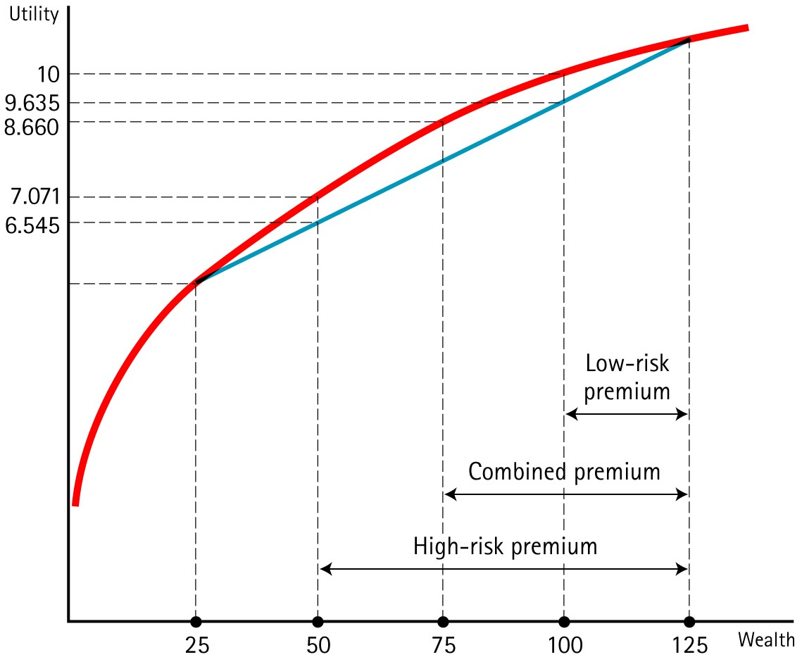
Adverse Selection in Insurance
Notes:
This figure is taken from Figure 15-1, on page 509 of the textbook. Suppose we have equal numbers of high and low risk drivers. Each insured starts with a wealth level of $125, but a loss can reduce the wealth to $25. The groups differ in the probability of loss. For the high-risk group, the probability of loss is 0.75, resulting in an expected loss of $75. For the low-risk group, the probability loss is 0.25, resulting in an expected loss of $25. If the insurer can distinguish between the two groups, respective competitive premiums of $75 and $25 can be charged. With premiums set at the expected value of loss for each insured, the Bernoulli principle implies that each would fully insure. Specifically, assuming square root utility, we find that the expected utility of insurance for the "low risk" drivers is 10, whereas the expected utility of self insurance for the "low risk" drivers is 9.635, so the "low risk" drivers happily buy insurance. Similarly, the expected utility of insurance for the "high risk" drivers is 7.071, whereas the expected utility of self insurance for the "high risk" drivers is 6.545, so the "high risk" drivers also happily buy insurance.
Now suppose that the insurer is unable to distinguish between high and low-risk drivers. If there are equal numbers in each group, the "break-even" premium will be $50. However, at this premium the low risk group will not insure because the utility of not insuring, 9.635, is greater than the utility of insuring and having a wealth level of $75 for certain, which is 8.660. Conversely, the high-risk group will find insurance to be a bargain and will choose to insure; by insuring for a premium of $50, their expected utility is 8.660, compared with expected utility of 6.545 if they don’t insure (indeed, insurance has become a significantly better deal!). Consequently (barring the imposition of a legal rule such as compulsory insurance), the portfolio composition will change as low risk drivers cancel their policies, leaving a portfolio of high-risk drivers (each having an expected cost of $75) and an inadequate premium.
Ask students for solutions to this adverse selection problem (hopefully someone will suggest compulsory insurance).

Slide 29
Resolving adverse selection through self-selection
Notes:
The Rothschild Stiglitz equilibrium cleverly restricts the menu of available choices in such a way that the insurer induces self selection. Here, the insurer offers contract L which involves partial coverage at an actuarially fair price (based upon the loss probability of the low risk insured), and contract H which involves full coverage at an actuarially fair price (based upon the loss probability of the high risk insured). The differences in the shapes of the indifference curves are due to the different accident probabilities, with a lower accident probability resulting in a more steeply sloped indifference curve. Here, the high risk policyholder optimally chooses contract H and the low risk policyholder optimally chooses contract L. The high risk policyholder prefers H over L because L would represent a point of intersection with a marginally lower indifference curve (here Ih is slightly above L). The low risk policyholder will prefer L, but would like a full coverage contract at the point of intersection of APl with the full insurance line. However, such a contract is not offered because both the low and high risk policyholders would choose it. Therefore, one of the social costs of adverse selection is that low risk policyholders are underinsured compared to a world where there is no adverse selection.
There is a very practical implication of this model. If you are a good risk, you owe it to yourself to select high deductible insurance. The problem with selecting a low deductible is that you will unnecessarily bear adverse selection costs if you follow this strategy.

Slide 30
Practical Implications of Rothschild-Stiglitz
The Rothschild-Stiglitz “separating equilibrium” model shows that an insurer can mitigate adverse selection by limiting the set of contract choices offered to consumers.
In the “real world”, insurers anticipate that bad risks will select lower deductibles than good risks; consequently, insurers adjust low deductible insurance policy premiums to reflect the anticipated cost of adverse selection.
Therefore, if you are a good risk, you ought to select high deductible insurance policies.

Slide 31
Class Problem 15.1
Assume that consumers are identical in all respects expect for their loss probabilities; some are high risk, and others are low risk.
Members of the high-risk group have loss probability p_{H} = 65%, whereas members of the low risk group have loss probability p_{L} = 35%.
Each consumer has initial wealth of $100 and utility U(W)=W^{.5}.
There are only two possible states of the world, loss and no loss. If a loss occurs, then consumers lose their initial wealth of $100.
Insurance contract offerings
Policy A provides full coverage for a price of $65.
Policy B provides full coverage for a price of $45.50.
Policy C provides 60% coverage for a price of $39.
Policy D provides 30% coverage for a price of $13.65.
Which policy pair should you offer, assuming that you are interested in maximizing profit?

