Slide 1
Lecture 4
Analysis of Costs and
Perfect Competition
Notes:
The first part of this lecture addresses the 5th chapter; the second part addresses the 6th chapter.

Slide 2
Introduction to Analysis of Costs
Even if a manager fully understands the relationship between inputs and outputs, she still cannot make “optimal” production decisions without cost information.
The key question managers must ponder is how are costs related to output?
A full understanding of costs is necessary since virtually any business decision requires a comparison between costs and benefits.
Lecture 4: Analysis of Costs and Perfect Competition
Notes:
Here, we introduce cost functions in addition to production functions which were the topic of Chapter 4!

Slide 3
Table 5.1: Fixed, Variable & Total Costs: Media Corporation
Lecture 4: Analysis of Costs and Perfect Competition
Notes:
Costs in the “short-run” - Some simple definitions will help us examine costs in the short-run (where the level of capital is fixed):
Total costs (TC) = Total fixed (TFC) + variable (TVC) costs
- Fixed costs are constant since they do not change as output varies in the short run (although in the long-run managers can alter them). Even if output is zero, fixed costs are still incurred. Fixed costs include items such as plant costs, plant maintenance, insurance, etc.
- Variable costs vary with output. If output is zero then variable costs are generally zero. Variable costs include salaries, raw materials, etc.
This is Table 5.1 from p. 130. The total cost relationship is TC = 100 + 50Q – 11Q² + Q³, which implies that MC = 50 - 22Q + 3Q².
What’s significant about Q=5.5 is that this is the point at which the average variable cost is minimized, and also corresponds to the point where the marginal cost function equals average variable cost (the fact that marginal cost equals average variable cost is shown in Table 5.2 on p. 132).
What’s significant about Q=6.64 is that this is the point at which the average total cost is minimized, and also corresponds to the point where the marginal cost function equals average total cost (the fact that marginal cost equals average total cost is also shown in Table 5.2 on p. 132).

Slide 4
Figure 5.1: Fixed, Variable & Total Costs: Media Corporation
Lecture 4: Analysis of Costs and Perfect Competition
Notes:
This is Figure 5.1 from p. 131. It simply represents a graph of the data in Table 5.1.

Slide 5
Table 5.2: Average & Marginal Costs: Media Corporation
Lecture 4: Analysis of Costs and Perfect Competition
Notes:
This is Table 5.2 from p. 132. The total cost function is TC = 50Q - 11Q² + Q³, which implies that MC = 50 - 22Q + 3Q².
Average fixed costs (AFC) = TFC/Q
Average variable costs (AVC) = TVC/Q
Average total costs (ATC) = TC/Q or AFC + AVC
Marginal costs (MC) = dTC/dQ
Note that MC = ATC when Q = 6.64; also MC = AVC when Q = 5.5. I.e., MC intersects AVC and ATC at their minimum levels.

Slide 6
Figure 5.2: Average & Marginal Costs: Media Corporation
Lecture 4: Analysis of Costs and Perfect Competition
Notes:
This is Figure 5.2 from p. 133. It simply represents a graph of the data in Table 5.2.
If marginal cost is below average cost, then average cost declines since the benefit of the incremental input is higher than average. When MC is higher than average cost, then average cost must increase.
MC intersects AVC and ATC at their minimum levels (at Q = 5.5 and Q = 6.64 respectively). The minimum of ATC always occurs at an output level higher relative to the minimum of AVC because of the presence of fixed costs.

Slide 7
Table 5.3: Thomas Machine Short-Run Costs
Lecture 4: Analysis of Costs and Perfect Competition
Notes:
Here, we go back to the Thomas Machine Company from chapter 4, where we fix capital in the short run and simply evaluate short run costs of operations, so the only variable input here is labor. The wage rate per unit of labor is $390.
This is TABLE 5.3 from pg. 136. It would be a good idea to discuss how the numbers were calculated (this can be seen by putting the table into spreadsheet display and looking at the code.
The production function for is Q = 30L + 20L² -L³; MP_{L} = 30 + 40L -3L², and W = 390 is the cost per unit of input (in this case, the wage rate per unit of labor).
At 6.67 units of labor, the marginal product of labor is maximized, which implies that marginal cost is minimized. At 10 units of labor, the average product of labor is maximized, which implies that average variable cost is minimized.

Slide 8
Chart of Table 5.3: Thomas Machine Short-Run Costs
Lecture 4: Analysis of Costs and Perfect Competition
Notes:
This is the graphical representation of the Table 5.3 (not in the book). Here, we find that the minimum MC occurs at Q = 792.6, and the minimum AVC occurs when MC = AVC = 3, which is when Q = 1,300.
By clicking on the graphic, one can also look at the data that produced this figure!

Slide 9
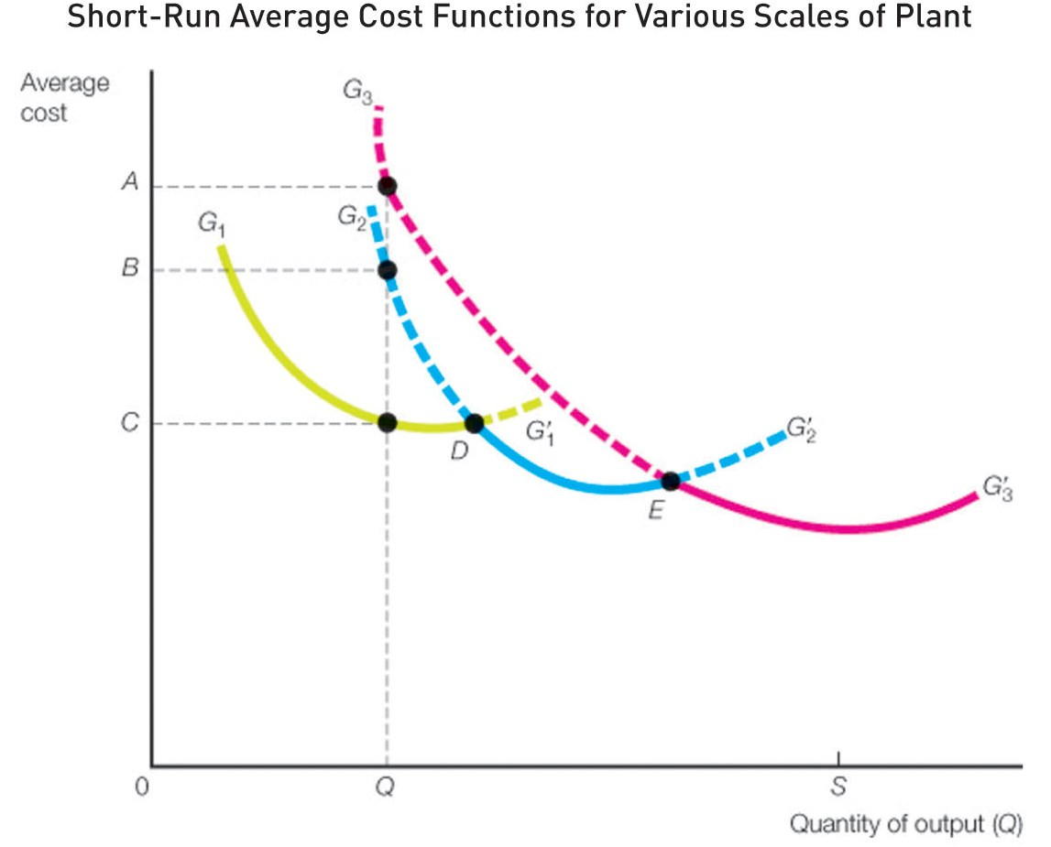
Lecture 4: Analysis of Costs and Perfect Competition
Notes:
The whole point of the analysis up to this point has been to illustrate that in the short run, the objective is to scale the firm’s variable inputs, given the capital input, at a level that minimizes average cost.
Now we are interested in figuring out long run costs. This requires mapping out the locus of the minimum cost points for all short-run average cost curves.
FIGURE 5.3 (pg. 140) shows a series of short-run average cost curves, each of which is defined by a different level of capital. Curves G1, G2, and G3 are each based on a different input bundle. Of the three, G1 is the minimum average cost over the output range of 0 to D. If the firm anticipates demand in the 0,D range, then the best plant size is represented by the fixed capital level implied by the G1 curve. G2 has the minimum average cost over the output range designated by points D and E. G3 has the minimum average cost after the output level designated by point E.
The idea here is that we can collect data like we had in Table 5.2 for varying levels of capital inputs, and use this information to develop a series (actually, a continuum) of short run average cost functions. Depending upon the expected level of demand, we’ll want to select the SRAC which provides for the lowest average cost, given our output expectations.

Slide 10
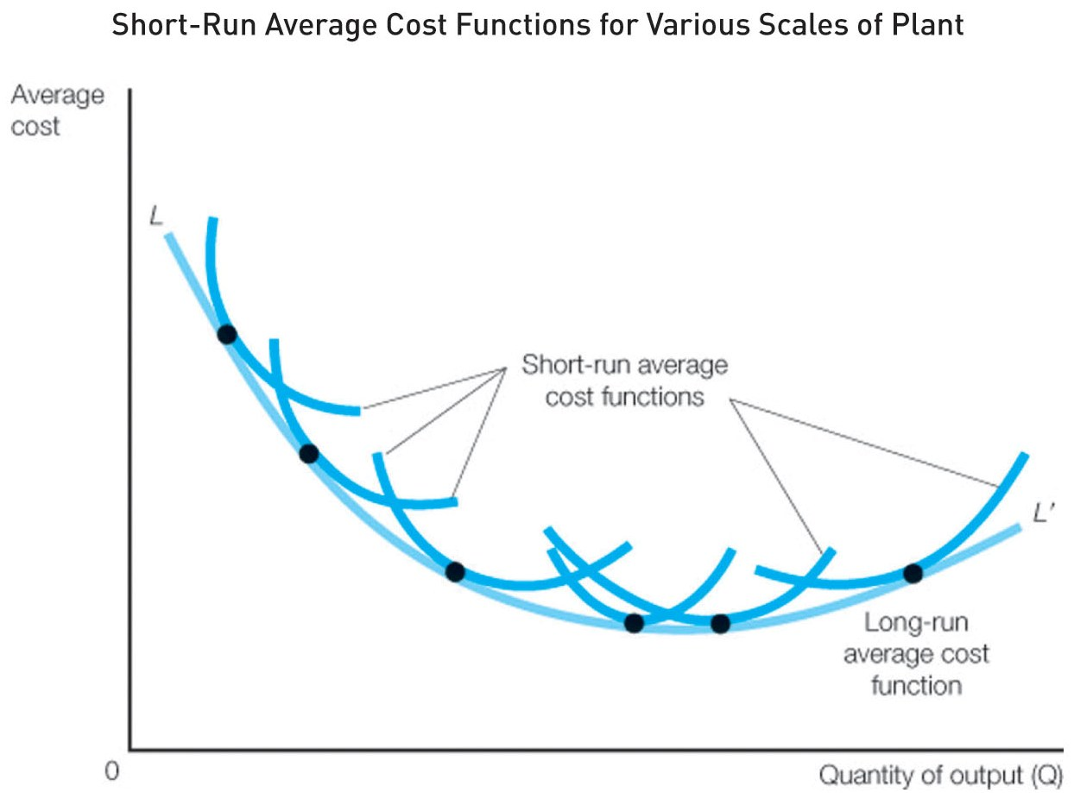
Lecture 4: Analysis of Costs and Perfect Competition
Notes:
FIGURE 5.4 (pg. 141) shows how these short-run average cost curves produce the long-run average cost curve. Any long-run cost curve is simply the lower boundary of the family of short-run cost curves. So for any output level, there is an optimal short-run total cost curve and average cost curve. Long-run cost curves simply traces these optimal (minimum) short-run cost curves.
Long- and short-run cost curves share many common characteristics:
- Like short run cost curves, long-run cost curves are u-shaped. The primary variable determining their shape is the presence of returns to scale. Empirically, most long-run cost curves are u-shaped; they initially exhibit increasing returns to scale (which is why they initially have negative slopes), then constant (this occurs over the region of the LRAC curve where the slope is flat), and finally decreasing returns to scale (which occurs over a region of the LRAC curve where the slope is positive). While long-run average cost curves share a similar shape with short-run average curves, the source of the shape is different. With short-run cost curves, the u-shape is caused by diminishing returns of inputs, with long-term curves it is the increasing, constant, and decreasing returns to scale.
- The long-run marginal cost curve intersects the long-run average cost curve at its lowest point. Long-run average cost is falling when long-run marginal cost is less than it, and rising when marginal cost is greater than it. The capital/labor ratio implied by this minimum point on the LRAC indicates the optimal scale at which to operate the firm in the long run!

Slide 11
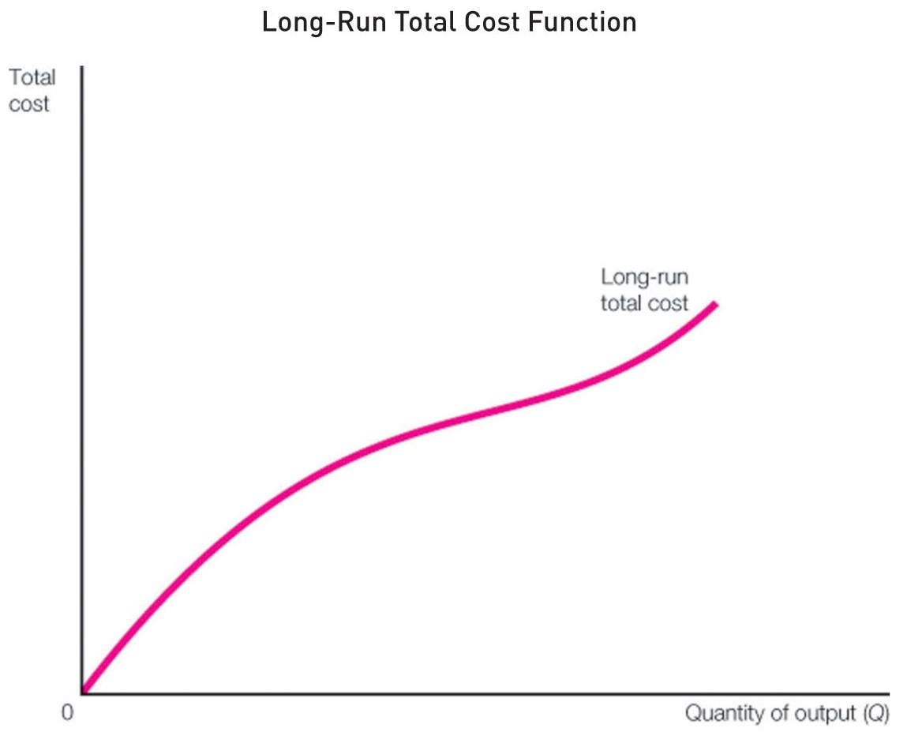
Lecture 4: Analysis of Costs and Perfect Competition
Notes:
FIGURE 5.5 (pg. 141) shows that long-run total cost is simply the long-run average cost multiplied by the number of units of output.
In the following chapters, we will incorporate information about the long run total cost function of the firm to determine the production decision that maximizes profit, given that we have fully optimized the scale and capital/labor ratio for the firm!

Slide 12
Managerial Use of Cost Functions (Martin Division)
Lecture 4: Analysis of Costs and Perfect Competition
Notes:
To illustrate the relationship between a firm's long-run and short-run cost functions, consider a Martin division that produces MP3 players.
The first question to ask, is what are turns to scale (answer: constant, since .5 + .5 = 1!).
In equation 5.2, we solve for L in terms of Q and K. In equation 5.3, we calculate total costs – labor is paid $8 per hour, and capital costs $2 per unit.
In equation 5.4, we compute the short run total cost, assuming that capital is fixed; specifically, we assume that K=10 (i.e., 10 thousand units of capital). AC_{s} and MC_{s} are then obvious.
Put all of these up on a flip chart so that I can subsequently reference them!

Slide 13
Managerial Use of Cost Functions (Martin Division)
Lecture 4: Analysis of Costs and Perfect Competition
Notes:
However, in the long-run, capital is not fixed. Therefore, let’s figure out the level of K that minimizes total cost! (it might help to rewrite 5.3 on the flip chart using a negative 1 exponent value on K; this way, we can apply the power rule!)
The marginal cost of capital (dTC/dK) is minimized in this case if K = Q/2 (note: check the second order condition (it’s positive!). Consequently, the optimal scale of operation involves purchasing half as many capital units as the number of products units that are in demand in the market.
In (5.5), we compute the long-run total cost function by substituting in the minimized marginal cost of capital (K = Q/2), and we find that TC_{L} is 2Q!
The equation after 5.5 confirms that we have also minimized the long-run average cost AC_{L} since AC_{L}= MC_{L}; therefore, the long-run average cost is $2 per MP3 player!

Slide 14
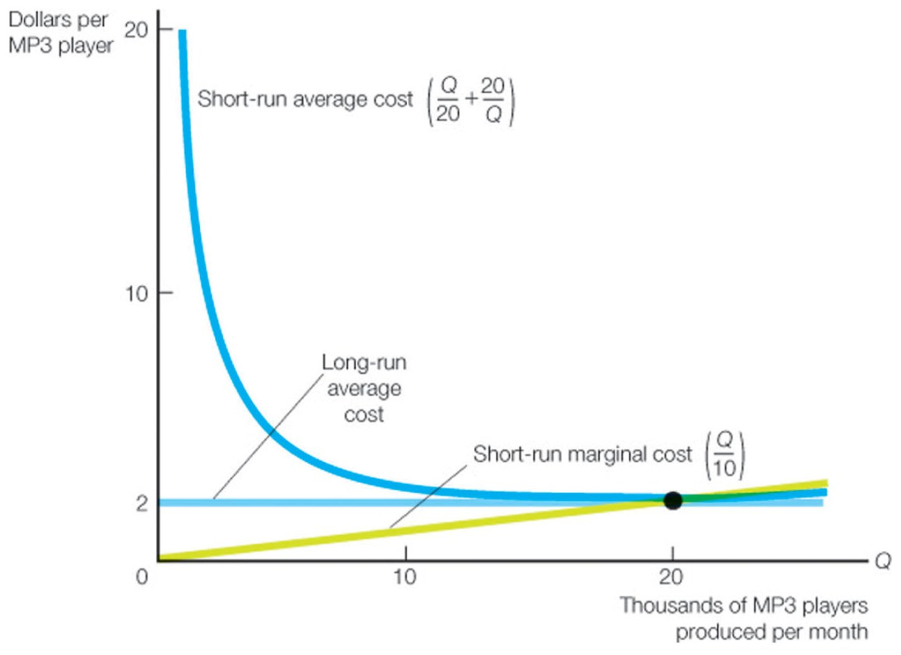
Lecture 4: Analysis of Costs and Perfect Competition
Notes:
This figure (which appears on p. 142 of the textbook) illustrates graphically the math that we showed on the previous two slides.
As is always the case, the short-run marginal cost function intersects the short-run average cost function at its minimum point, where Q = 20 and AC_{s} = 2. At this point, short run average cost = long-run average cost = short term marginal cost = long-run marginal cost.
Here, the quantity which minimizes long-run average cost is Q = 20,000 MP3 players per month.
The total cost function here is horizontal because the production function exhibits constant returns to scale. As we have previously discussed, it is not uncommon for there to be some scale economies in the real world (over at least some range of output).
In the real world, scale economies are not necessarily confined to production only; they can be found in most business processes, including distribution, raising capital, advertising, and most business processes. The text notes that

Slide 15
Examples of Economies of Scale
Managers at UPS use scale economies in their distribution network to decrease costs.
Exxon Mobil managers use scale economies to decrease costs in their refining and chemical production processes.
The size of cruise ships keeps growing because larger ships have a lower cost per passenger thanks to scale economies.
Others???
Notes:
These examples are given on p. 146. In the case of UPS, this information enables UPS to figure out how to best tweak its distribution system so as to take maximum advantage of the scale economies in its distribution network. Sometimes there are counter-intuitive results here; e.g., how Fedex routes most of its deliveries through memphis.
Perhaps students can also cite some other examples.

Slide 16
Class Problem 5.1
Gold Screen Inc. (GSI) manufactures screens for color-television sets. GSI has manufacturing facilities in California, and the firm is considering opening a plant in Asia.
GSI’s engineers estimate the cost function of the new plant to be: TC = 800,000 + 40Q +0.0025Q²
GSI expects to sell 15,000 screens this year, and expects demand to grow in the future.
What is the expected total cost and average cost for sales of 15,000 screens?
Calculate the output level that will yield the lowest average total cost.
Notes:
Solve this problem on the flip charts!

Slide 17
Economies of Scope
Notes:
In equation 5.6, C(Q₁) indicates the cost of only producing product 1, C(Q₂) indicates the cost of only producing product 2, and C(Q₁+Q₂) represents the cost of producing these products jointly.
The example given here indicates that the Martin Company enjoys economies of scope. Basically, it represents a simple synergy measure. The numerator represents the net cost benefit of joint production, as a proportion of the cost of joint production.

Slide 18
Examples of Economies of Scope
Cable TV, high speed internet, and VOIP services
Timber and particle board production
Corn and ethanol production
Power generation and distribution
Joint cargo and passenger transportation by airlines
Others???
Notes:
Another example which comes to mind is how Proctor & Gamble produces hundreds of consumer products ranging from razors to toothpaste; by spreading marketing costs across product lines, P&G lowers the average cost for each product. This is also certainly the case with Time Warner Cable and AT&T’s “triple play” product options.
Economies of scope arise from “complementarities” that may exist in the production or distribution of goods or services. The common denominator here is the spreading of costs across more than 1 different activity.

Slide 19
Perfect Competition
Characteristics of perfect competition
Many firms producing identical products with no control over price, no non-price competition (e.g., advertising is unnecessary since identical products cannot be meaningfully differentiated), no barriers to entry or exit
Examples include agricultural markets, commodity markets, financial markets, eBay auctions, open source software, etc.
No buyer or seller has any market power; firms in such a market act as “price takers” (i.e., take prices as “given”), and economic profit = 0.
Notes:
Perfectly competitive markets are not strategically interesting because managers cannot affect behavior in them. However, they lay the groundwork for our examination of more strategically interesting markets where managers must consider (and anticipate) the actions of other market players (e.g., consumers, rivals) in setting prices. The cases of monopoly, monopolistic competition, and oligopoly are specifically addressed in the next set of chapters that we will be covering.
If we translate the economic profit = 0 into financial terms, this is consistent with the firm earning a “fair rate of return”, where NPV = 0. Zero economic profit is fair, in that it enables the firm to cover opportunity costs, but the firm cannot reasonably expect to earn “excess” profits.

Slide 20
Monopoly and Monopolistic Competition
Characteristics of monopolistic and monopolistically competitive markets
Control over price is either complete (monopoly) or limited (monopolistic competition); thus firms set prices and quantities and earn economic profits.
However, market power is not unlimited; firms must consider willingness of consumers to pay.
Entry barriers are very high in monopolistic markets; low in monopolistically competitive markets.
“Obvious” examples of monopoly include public utility firms; retail trade is typically given as an “obvious” example of monopolistic competition.
Notes:
In chapter 7, we study Monopoly and Monopolistic Competition.
Monopolistically competitive markets are strategically more interesting because managers must consider (and anticipate) the actions of other market players (e.g., consumers, rivals) in setting prices. The same point applies in the case of oligopoly (where there exists a limited number of firms and the barriers to entry and exit are high).
Advertising and product differentiation are used in monopolistically competitive markets to distinguish one firm’s products from another’s; e.g., think about commercials for companies like hotel chains and travel industry websites!
More recently (during the past 15 years or so), Microsoft has had repeated confrontations with the Federal Trade Commission, Department of Justice, and European Community-equivalent regulatory organizations involving anti-trust regulatory actions. In these actions, Microsoft is characterized as a monopolistic firm, although it might be more accurate to characterize Microsoft as an oligopolistic firm, since the markets in which it competes are (at least in principle) contestable; e.g., in the operating system space, you have Mac OS, various flavors of Unix, Linux, etc., and in the office suite space, you have open-source software (e.g., Star-office and Google Office software).

Slide 21
Oligopoly
Characteristics of oligopolistic markets
Limited number of firms and high barriers to entry.
“Obvious” examples of oligopoly include the automobile, airline, pharmaceutical, and overnight (express) delivery industries (e.g., UPS and FEDEX),
Behavior of firms in an oligopolistic market is often difficult to predict
Sometimes firms compete vigorously; e.g., Coke and Pepsi, airline industry
Sometimes they explicitly or implicitly collude (the OPEC cartel)
Notes:
In Chapter 10, we study oligopoly.
E.g., see http://econblog.garven.com/2009/10/21/the-economics-of-the-market-for-swine-flu-vaccine/ for my discussion of the oligopolistic structure of the global vaccine market that is contested by only four companies: GlaxoSmithKline, Sanofi-Aventis, Novartis AG and AstraZeneca.

Slide 22
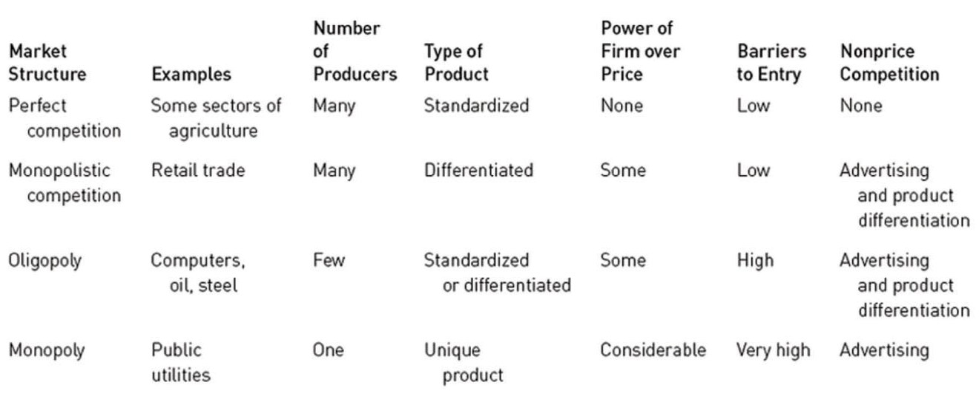
Table 6.1. Characteristics of Perfect Competition, Monopolistic Competition, Oligopoly, and Monopoly
Lecture 4: Analysis of Costs and Perfect Competition
Notes:
Perfectly competitive markets are not strategically interesting because managers cannot affect behavior in them. However, they lay the groundwork for our examination of more strategically interesting markets where managers must consider (and anticipate) the actions of other market players (e.g., consumers, rivals) in setting prices. The cases of monopoly, monopolistic competition, and oligopoly are specifically addressed in the next set of chapters that we will be covering.
In an oligopoly, sellers are so few that the actions of any one of them will materially affect price and have a measurable impact on competitors. Firms will sometimes, but not always, produce identical products; e.g., in steel and aluminum they do, while in autos, they do not.

Slide 23
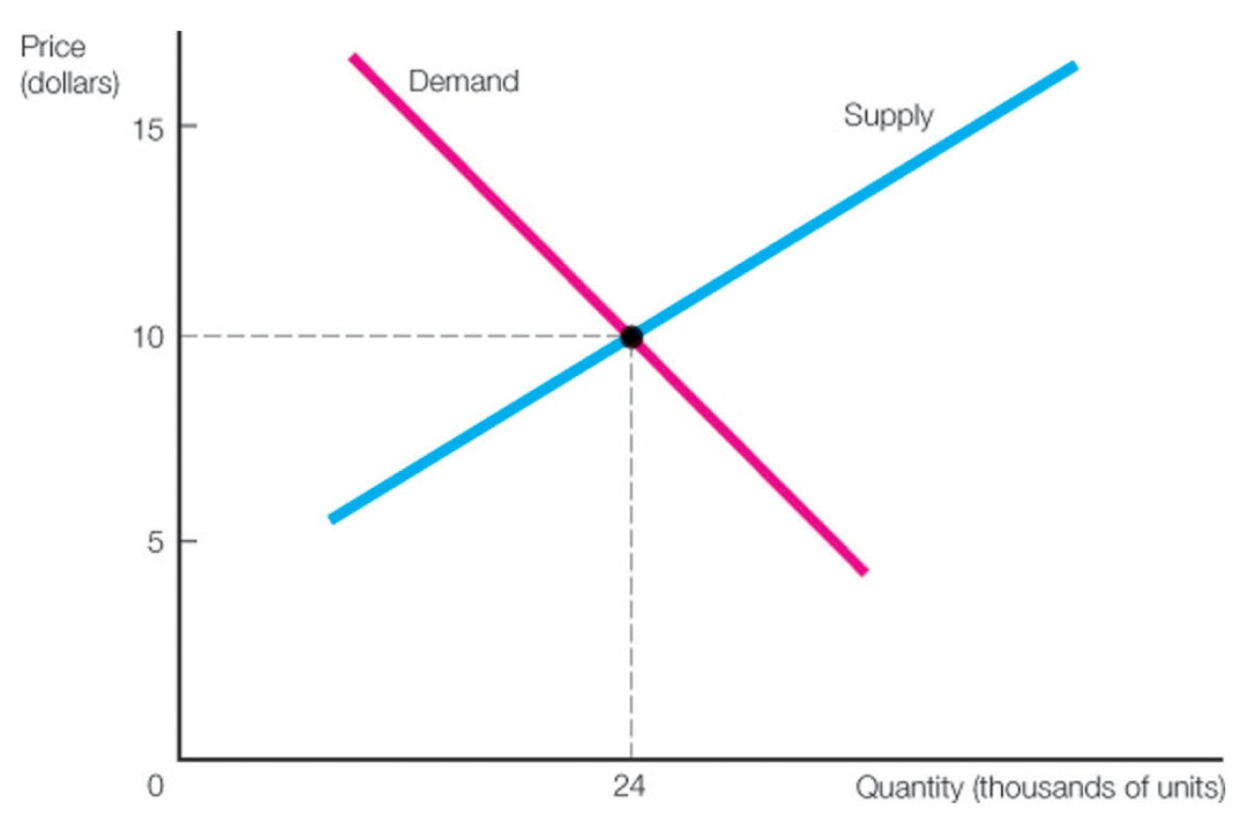
Figure 6.1. Determination of Price in a Perfectly Competitive Market
Lecture 4: Analysis of Costs and Perfect Competition
Notes:
Here, demand is given by P = 22 – 0.5Q_{D} (equation (6.1), whereas supply is given by P = 4 + 0.25Q_{S} (equation (6.2), both on p. 172. The equilibrium price is found by equating demand and supply:
P = 22 – 0.5Q = 4 + 0.25Q ⇒ 0.75Q = 18
⇒ Q 24 thousand units, and P =10 per unit.
Suppose there are 1,000 firms in this market, and that each produces on average 24 units. Even if one of these firms doubled its output, the effect on price would be negligible (1.2 cents). So for all practical purposes, at the firm level demand is essentially horizontal (with an intercept of $10), which means that demand is perfectly elastic (specifically, price elasticity of negative infinity).

Slide 24
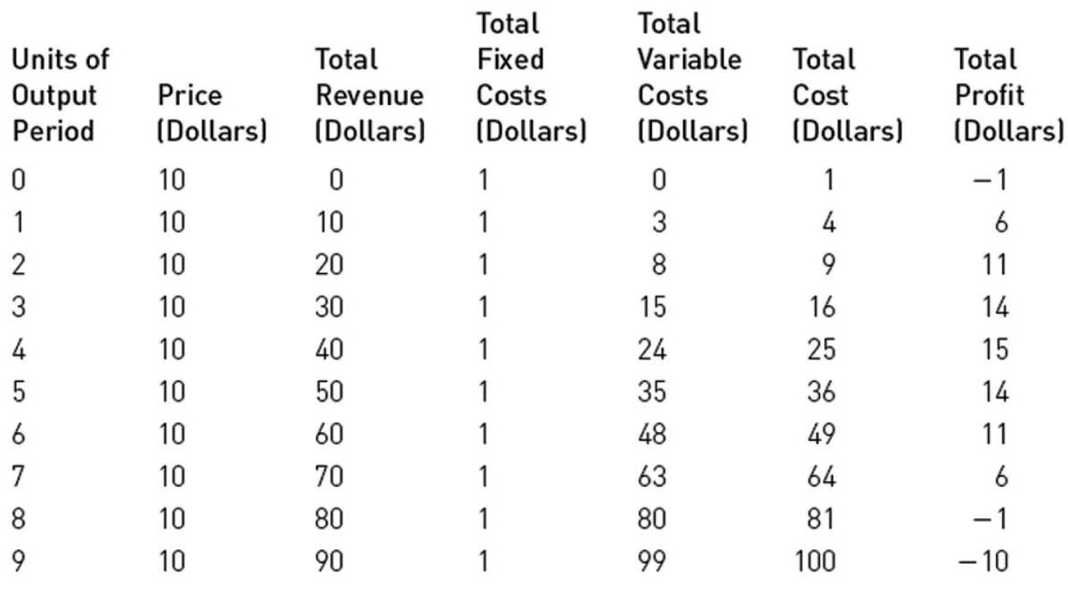
Table 6.2. Costs and Revenues of a
Perfectly Competitive Firm
Lecture 4: Analysis of Costs and Perfect Competition
Notes:
Next, we consider the output decision of a perfectly competitive firm.
Table 6.2 appears on p. 175 of the textbook. Total variable cost is given as TVC = 2Q +Q², and total cost is 1 + 2Q +Q². Therefore marginal cost is 2+2Q, so the optimal quantity is determined by seting MR = MC; i.e., when 10 = 2+2Q; therefore, Q = 4, at which point profit is 15.

Slide 25
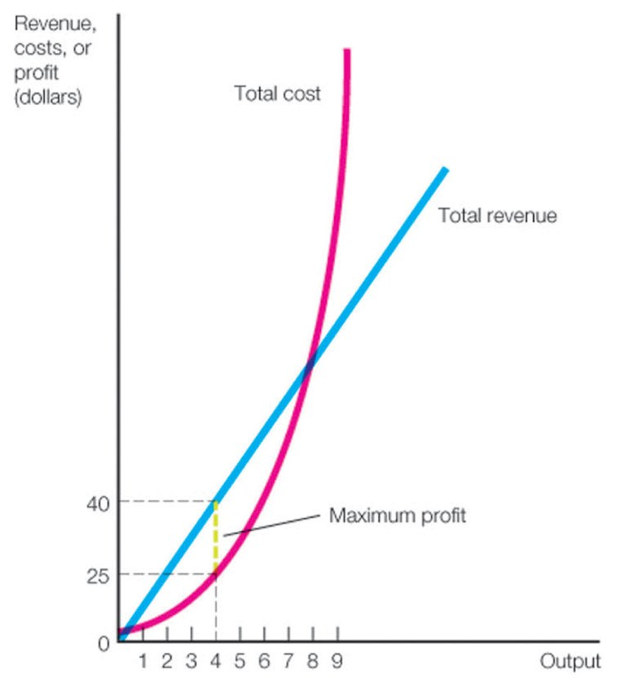
Figure 6.2. Relationship between TC and TR of a Perfectly Competitive Firm
Lecture 4: Analysis of Costs and Perfect Competition
Notes:
Figure 6.2 further illustrates why the slopes of the total cost and total revenue functions are equal when profits are maximized; thus the logic for the MR=MC condition!

Slide 26
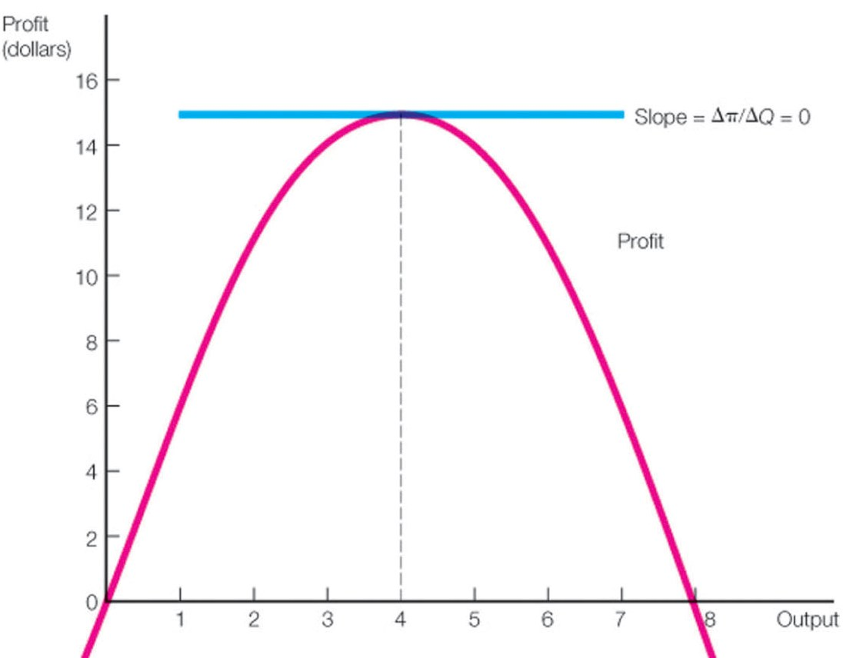
Figure 6.3. Relationship of π and Q of a Perfectly Competitive Firm
Lecture 4: Analysis of Costs and Perfect Competition
Notes:
This is a graphical illustration of Table 6.2. Profit is π = 10Q - 1 - 2Q - Q², so the first order condition is 10 -2 -2Q = 0 which implies that Q =4. Thus the profit maximizing firm can determine optimal output by simply setting price equal to marginal cost.
Note that in order for this to be a maximum, the second order condition must be satisfied. Since the first order condition requires that MR-MC=0, it follows that dMR/dQ – dMC/dQ < 0. However, dMR/dQ = 0; i.e., the perfectly competitive firm is a price taker, so the rate of change in price as a function of quantity is 0; the same price is charged no matter what. However, dMC/dQ = 2 > 0, which implies that dMR/dQ – dMC/dQ < 0.

Slide 27
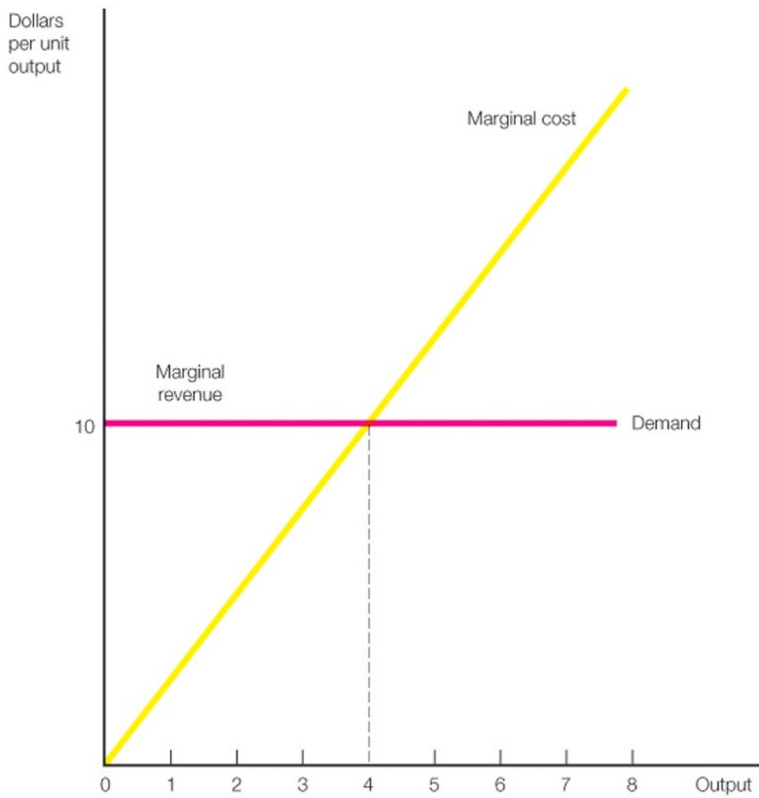
Figure 6.4. MR and MC of a Perfectly Competitive Firm
Lecture 4: Analysis of Costs and Perfect Competition
Notes:
Figure 6.4 further illustrates the point raised in the previous graph (Figure 6.3); i.e., that marginal cost for a perfectly competitive firm is increasing in output, whereas marginal revenue is constant.
Here, MC = 2+2Q, and MR = P = $10 (since price is effectively fixed for the perfectly competitive firm). Therefore, the optimal output decision for this firm is 4 units of output. The firm will earn profit of 40 – 25 = $15, but this is a profit that compensates the firm for its cost of capital, and nothing more; i.e., this corresponds to zero economic profits – the capital could have been used in some other activity which would have earned $15 profit, so zero economic profits simply means that opportunity costs of capital get covered.

Slide 28
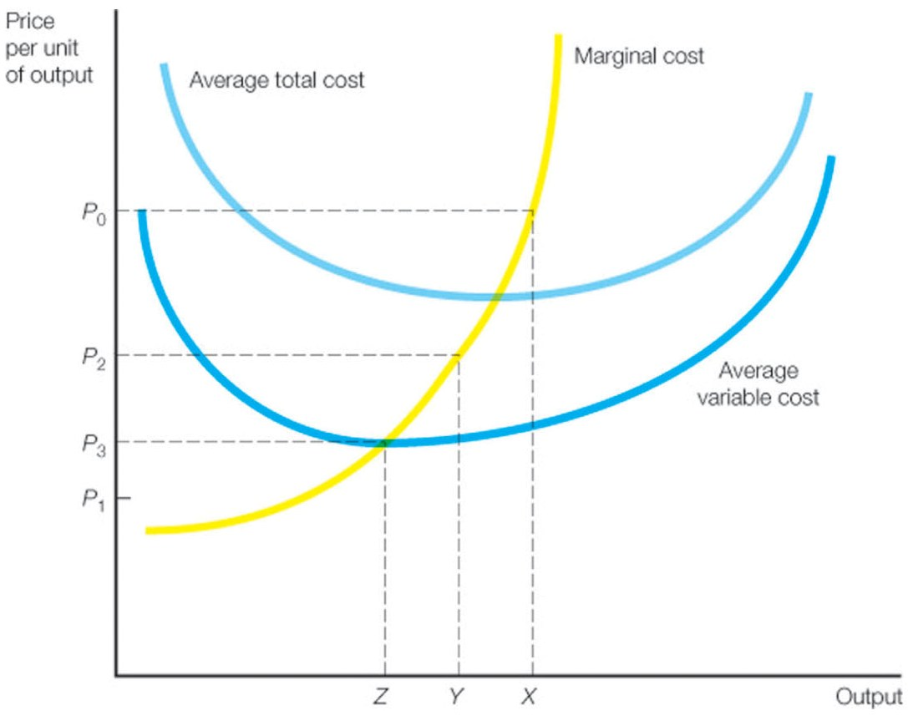
Figure 6.5. Short-Run Average and Marginal Cost Curves
Lecture 4: Analysis of Costs and Perfect Competition
Notes:
Figure 6.5 appears on p. 181 of the textbook. This figure established the bounds for determining whether or not a firm should produce output in the short run.
If there is an output level where price exceeds average variable cost, it pays the firm to produce in the short run, even though price does not cover average total costs. This is illustrated in Figure 6.5, where price is given by P₂; here, although the firm is not fully covering fixed costs, it at least is more than covering average variable cost. If price were P₃, the firm would be indifferent about producing in the short run. However, if the price were P₁, the firm is better off to produce nothing at all, even in the short run. The point (Z, P₃) output-price pair represents the shutdown point for the firm.
To summarize, under perfect competition, the firm sets output so that the short-run marginal cost equals the price and the marginal cost is rising (this guarantees maximum profit or minimum loss). However, if the market price is below average variable costs at every output level, it minimizes losses by discontinuing production.

Slide 29
The Kadda Company (Numerical Example)
Lecture 4: Analysis of Costs and Perfect Competition
Notes:
This numerical example appears on p. 182 in the “Problem Solved” box. The Kadda Company competes in a perfectly competitive industry, and its cost function is given as the first equation in this slide. We want to determine whether Kadda should operate in the short run; i.e., is the market price for its output greater than Kadda’s average variable cost (AVC).
Setting MR = MC, Kadda should produce 6 units. Since the price is greater than the AVC, since by producing 6 units, losses are only $728, compared with $800 if Kadda exits the business entirely.

Slide 30
The MRP = MRE rule
Notes:
This corresponds to equation (6.8) on p. 185. I simply generalized the notation to allow for evaluating the marginal productivity of any factor input (the text uses labor).

Slide 31
Class Problem 6.1
Crude oil is carried by pipelines from oil fields and storage areas over hundreds of miles to urban and industrial centers. Output is the amount of oil carried per day, and the two principal inputs are pipeline diameter and the horsepower applied to the oil carried. Suppose that an oil company estimates that throughput per day in its pipeline is given by
Q = 286H^{0.37},
where H is horsepower usage, which costs $30 per unit, and throughput has a marginal revenue of $2 per unit. Use the MRP = MRE rule to figure out the profit maximizing level of horsepower usage for this company.

Slide 32
Market Equilibrium
In the short run, output will occur where MR = MC, and revenue is greater than variable cost.
Above-normal short-run profits are possible; e.g., one firm may have lower costs than its rivals.
However, if markets are competitively structured, then long-run economic profits get quickly dissipated.
Suppose such profits exist; then new firms will enter the market (since there are no entry barriers), output will increase, and price will fall until zero economic profits are earned.
Notes:
These dynamics are implied by Figure 6.8 (p. 189) in the textbook.

Slide 33
Market Equilibrium
Long-run market equilibrium in perfectly competitive markets is characterized by:
Market demand equals market supply.
No consumer wishes to change the amount of goods or services she is buying.
Incumbent firms have no interest in changing their production decisions; no further market entry or exit, and firms produce at the point of the minimum average total cost on their long-run average cost curves.
Notes:
The competitive market equilibrium is often referred to as a “Pareto optimum”. The property of Pareto optimality is that social welfare (sum of producer and consumer surplus) is maximized, and no further improvements in welfare for firms or consumers are possible (any changes involve making someone worse off).

