Slide 1
Lecture 1
Introduction to
Managerial Economics
Notes:
Goals for the first class meeting
First, to address with various administrative issues pertaining to the course; e.g., course website, syllabus, etc.
Secondly, to present a lecture and discussion of Chapter 1 in the textbook.

Slide 2
Professor Information
Current and previous academic appointments
  Hankamer School of Business, Baylor University: Professor of Finance and Insurance (2000-Present) and Frank S. Groner Memorial Chair of Finance (2002-Present)
  The Wharton School of the University of Pennsylvania: Visiting Scholar (2007-present)
  Previous faculty appointments at Penn State (1984-1989), UT-Austin (1989-1996), LSU (1998-2000), and Wharton (Spring 2006 Semester) Business Schools
Research: Application of economics and finance to the analysis, pricing, and management of risk.
Service: Associate editor of two journals: Geneva Risk and Insurance Review and Journal of Risk and Insurance; Past President of two academic associations: American Risk and Insurance Association and Risk Theory Society.
Notes:
Although my PhD is in finance and not in economics, my research and other teaching is based heavily upon applications of microeconomics, primarily pertaining to risk and uncertainty.
More information about me and my research, teaching and service are available from my personal website at http://www.garven.com. Also, my personal blogsite is at http://blog.garven.com.

Slide 3

Textbook: Allen, W. Bruce, Weigelt, Keith, Doherty, Neil A., and Edwin Mansfield, 2009, Managerial Economics (7th edition), W. W. Norton (ISBN: 0393932249).
Notes:
I may also on occasion assign other readings from sources other than the textbook; if and when this occurs, these readings will be distributed from the following webpage: http://economics.garven.com/readings.

Slide 4
Course Goals
Learn to use economic models to think critically about everyday problems.
Know what conditions characterize competitive outcomes and efficient allocations of resources.
Understand how firm cost structure and the nature of the market determine prices and production; learn how firms with pricing power can exploit variation in demand to price discriminate and maximize profits.
Apply strategic thinking to decision-making and know how to use it to analyze firm and individual choices.
Understand how risk influences decision-making and the design of real world contracts.
Notes:
Also, an important goal for the course is to also have fun while we accomplish these goals!
Strategic thinking includes game theory, in which we learn about how to solve games by looking to the future, anticipating what strategy our competitors will choose, and then choosing an action that is rational, based on those beliefs. In multi-period (sequential) games, backward induction involves starting with the last decisions in the sequence and then working backward to the first decisions, identifying all optimal decisions along the way.
We finish the course with a healthy dose of decision theory, which looks at how people and firms make decisions when there is risk and incomplete information. I have built my academic career researching various issues which fit neatly into this last topic.

Slide 5
Grade Determination
Final Grade = .30(Problem Sets) + .30(Midterm Exam 1) + .40(Final Exam)
The midterm exam will occur in class on Thursday, November 5. The final exam will occur during the final class session on Monday, December 14.
Notes:
The final exam is comprehensive in nature.
Here, it would be good to point out that the 10/1, 11/5 and 12/14 classes are 4 hours (not that this much time will necessarily be needed on 11/5 and 12/14 when the exams are given. Otherwise, the other classes will be scheduled for 3 hours. I’ll try to keep to 3 hours on those evenings (start promptly at 6, end by 9), but may run over a few minutes here or there depending upon the topic that we’re covering.
Also point out that since there are no formal cases, I am not going to grade class participation, but nevertheless encourage students to speak up, discuss, and ask questions, since this is obviously an important part of the learning process.

Slide 6
Microeconomics and Macroeconomics
Microeconomics represents the branch of economics which deals with the behavior of individual economic units—consumers, firms, workers, and investors—as well as the markets that these units comprise.
Macroeconomics represents the branch of economics which deals with aggregate economic variables, such as the level and growth rate of national output, interest rates, unemployment, and inflation.
Notes:
The two main disciplines under the heading of “economics” are microeconomics and macroeconomics. Most of the specialty fields within economics typically fall primarily under one of these two categories; e.g., managerial economics involves the application of microeconomics to analyze managerial actions and their effect on firm performance.

Slide 7
Managerial Economics
Managerial economics involves the application of microeconomics to analyze managerial actions and their effect on firm performance.
  The purpose of this analysis is to shed light on concepts such as cost, demand, profit, competition, pricing, compensation, and business strategy.
  With its focus on behavior, managerial economics provides powerful tools and frameworks to guide managers to better decisions.
Notes:
The other required economics course in the EMBA program (ECO 5110, entitled “Key Global Economic and Strategic Issues”) is offered in the final semester and has more of a “macro” orientation.
A good example of a powerful decision-making tool is backward induction, which is the process of reasoning backwards in time, from the end of a problem or situation, to determine a sequence of optimal actions. This decision-making framework is used in game theory, as well as various other settings.

Slide 8
Business and the Social Sciences
Economics, psychology, and sociology represent the “parent” social sciences upon which most business disciplines are based.
  Managerial economics, finance and accounting draw primarily on economics (especially micro), whereas management and marketing tend to be based primarily upon psychology and sociology.
    Counterexamples include behavioral economics and finance, use of econ-based pricing strategies in marketing, application of game theory in management strategy, etc.
Notes:
Behavioral economics and finance attempt to incorporate aspects of psychology into their models. Examples include:
Economics: reform of pension laws in 2006 which set 401-K enrollment as the default option from which workers opt out, instead of the other way around (behavioral economics research has shown that people often tend to be rather lethargic about taking actions).
Finance: Rational choice models imply that investors try for the best possible tradeoffs between risk and return; however, psychological research suggests that investors may prefer avoiding losses to acquiring gains (note that if this is the case, it could create retirement security problems in society). This behavioral tendency is commonly referred to as “loss aversion”
Aspects of accounting also utilize psychological principles; e.g., in the area of auditing.
Marketing makes extensive use of economics (e.g., formulation of pricing strategies based upon price elasticity) and some management theorists use game theory concepts.

Slide 9
Managerial Economics
Where does managerial economics fit within the EMBA curriculum?
  Managerial economics is a standard first-year course requirement in most EMBA programs.
  This course differs conceptually from other first-year courses in that it (like QBA 5330) focuses upon the analytic foundations for decision-making that are subsequently applied in “core business foundations” courses such as accounting, finance, and marketing.
Notes:
The “official” course description is that ECO 5315 is “…designed to cover aspects of micro-theory that are relevant for decision making within the firm. Emphasis is placed on the decision-making process.”

Slide 10
Internet Resources
Class website: http://economics.garven.com
  The source for readings, lecture notes, problem sets, etc.
  For links requiring authentication, use “econ” as your username and “baylor” as your password (all lowercase).
Class weblog: http://econblog.garven.com
  I use the class blog to post important announcements and provide insights linking course topics with the “real” world.
Notes:
At this stage of the lecture, I’ll obviously want to show the website and blogsite to the students
Start by showing the blogsite and show how to receive the blog as a news feed, email subscription, or Twitter feed, and how to comment (note that I moderate comments to prevent getting spammed).
Next, go over the class website. Besides showing the major areas, also spend some time discussing the recommended links. Basically, this is a good place to go for supplementary reading and listening, not only during class but during one’s life!
After covering the websites, this might be a good point at which to take the first break of the evening! I think I will default to having 10 minute breaks at 6:50, 7:50 and 8:50, but may alter this depending upon the material that we happen to be covering on any given night.

Slide 11
Why all the math?
Perspective from the great master, Alfred Marshall:
In a letter to his protégée, A.C. Pigou, he [Marshall] laid out the following system: “(1) Use mathematics as shorthand language, rather than as an engine of inquiry.
(2) Keep to them till you have done. (3) Translate into English. (4) Then illustrate by examples that are important in real life (5) Burn the mathematics. (6) If you can’t succeed in 4, burn 3. This I do often.”
Source: Todd G. Buchholz, 1989, New Ideas from Dead Economists, New York: Penguin Group, p. 151.
Notes:
From Wikipedia: “Alfred Marshall (born 26 July 1842 in Bermondsey, London, England, died 13 July 1924 in Cambridge, England) was an English economist and one of the most influential economists of his time. His book, Principles of Economics (1890), brings the ideas of supply and demand, of marginal utility and of the costs of production into a coherent whole.”
In other words, the focus is not on the math per se; rather, it is on the use of math to help clarify one’s thinking about real world problems, a point echoed by Krugman on the next page of this lecture note.
Point 6 is that if the math doesn’t give you a plain English theory that works in the real world, then burn the plain English theory!

Slide 12
Why all the math?
Perspectives from the economics blogosphere:
  Nobel laureate Paul Krugman notes that “Math in economics can be extremely useful”, and that math can serve an essential analytic function by helping to clarify one’s thoughts.
  Greg Mankiw notes that “Math is good training for the mind. It makes you a more rigorous thinker.”
  Jason DeBacker observes that math helps to quantify tradeoffs, and that using math “…puts in plain sight the assumptions that lie behind a model and the mechanisms at work in the model”.
However, it is also important to remember that it is better to be vaguely right than precisely wrong!
Notes:
The famous quote “it is better to be vaguely right than precisely wrong” is commonly (and incorrectly) attributed to the famous economist John Maynard Keynes, but it certainly is consistent with the views of not only Keynes, but also Marshall and most other prominent economists, dead or alive. This is also consistent with Marshall’s comments!

Slide 13
Discrete (algebra) versus continuous (calculus) analysis
In the textbook’s preface (cf. pp. xx), the authors note that given the choice between algebra and calculus, the average student prefers algebra.
The authors use both algebraic and calculus-based analytic approaches; however, so long as one understands basic calculus, the latter approach is often easier to grasp.
For those students whose math skills may be a bit on the "rusty" side, I recommend reviewing Appendix A (pp. 597-626) of the textbook.
Notes:
I would argue that using calculus rather than algebra is actually quite a bit easier, so long as one knows how to do very basic differentiation, which is the case for this course. This approach also fits better with the math behind optimization which depends critically upon the calculus and appears throughout the course.
Candidly, the whole point about discrete versus continuous has a lot more to do with the business strategy of the textbook publisher than the preferences of the authors. W. W. Norton claims that by removing (or de-emphasizing) calculus, that this enhances the book’s marketability (by as much as 30%). However, this business decision comes at a cost of pedagogical clarity, so the textbook authors themselves rely primarily upon the calculus in their courses. The whole idea of inserting “quant boxes” (e.g., see page 38) was largely a compromise between pedagogical clarity insisted upon by the authors on one hand and WW Norton’s hope of increased sales on the other.
In what follows, I show 1) when one analyzes equations for lines, then discrete equals continuous for all values of x, 2) for nonlinear functions such as a parabola (y = x²), slope values depend upon the value assumed by x, and in this case, the discrete analysis implies that you approximate the nonlinear function with a series of piece-wise line segments, or chords. On page 17, it seems (heuristically) obvious that as Dx goes toward 0, then one gets a parabola from an arbitrarily large number of chords!

Slide 14
QBA 5330 Review: Calculating Derivatives
Notes:
The slope definition shown here clarifies the difference between discrete and continuous changes. Specifically, differential calculus simply involves calculating slopes of functions involving infinitesimally small changes in the x axis variable. In this sense, the continuous is a “special case” of the discrete.
This states that the rate of change of a straight line is a constant equal to the slope of the line. In other words, no matter what the value of x, the straight line function increases at a constant rate of change.
In this case, there is no difference at all between a discrete versus a continuous (infinitesimally small) change. For example, suppose we want to know δy/δx, where x changes from 4 to 6. Therefore, δx = 2, and δy = 10 + 5(4) + 5(2) – (10+5(4)) = 10+20+10-30 = 10. Consequently δy/δx = 5, for both the discrete and continuous cases. In other words, it doesn’t matter how large (or small) δx is; we always get the same exact slope value! (it would probably be a good idea here to also draw line to this effect!).

Slide 15
QBA 5330 Review: Calculating Derivatives
Notes:
This is the graph of the line y = 10 + 5x; as one can see, the line has a constant slope of 5. Irrespective of where one is on the graph, for every 1 unit change in the x axis variable, the y axis variable changes by 5 units.
Separately on the board (or Elmo device), indicate the ratio (f(x+dx)-f(x))/dx.

Slide 16
QBA 5330 Review: Calculating Derivatives
Notes:
This is the graph of the quadratic function y = x^2; here, the slope depends upon the value for x. The minimum point for x here is at x = 0; note that we can see that this is a minimum since any movement to the right or left of x = 0 results in a higher value for y; i.e., the second derivative of y = x^2 = 2 > 0. Therefore, at x=0, y doesn’t change with an infinitesimally small change in x. However, at x =2, the rate of change in y is 4 times greater than the rate of change in x, and at x = 4, the rate of change in y is 8 times greater than the rate of change in x.

Slide 17
QBA 5330 Review: Calculating Derivatives
Notes:
This is the graph of the line y = x^2; here, the slope depends upon the value for x. The minimum point for x here is at x = 0; note that we can see that this is a minimum since any movement to the right or left of x = 0 results in a higher value for y; i.e., the second derivative of y = x^2 = 2 > 0. Therefore, at x=0, y doesn’t change with an infinitesimally small change in x. However, at x =2, the rate of change in y is 4 times greater than the rate of change in x, and at x = 4, the rate of change in y is 8 times greater than the rate of change in x.
The important thing to note here is that with nonlinear functions like this one, the value of the slope depends upon the value for the x axis variable; i.e., it is not constant as in the case of a line.

Slide 18
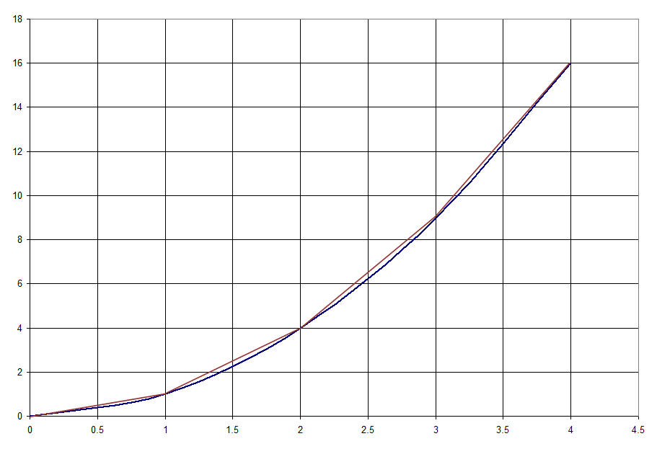
QBA 5330 Review: Calculating Derivatives
Notes:
Here the blue line is the value of the function for non-negative values of x. I have drawn in (using an orange-brown color) the secants or chords between the function values for x=0 and x=1, for x=1 and x=2, x=2 and x=3, and x=3 and x=4.
The next page provides the slope values for the various chords (based upon dx = 1) and compares them with the exact values at x = 0, x=1, x=2, and x=3.

Slide 19
QBA 5330 Review: Calculating Derivatives
Notes:
This page illustrates slope values for the various chords (based upon dx = 1) and compares them with the exact values at x = 0, x=1, x=2, and x=3.
The key intuition here is that the discrete approach generates errors, in that it uses piece-wise line segments to come up with an approximation of a quadratic function.
For a convex (concave) function (which increases at an increasing (decreasing) rate), it will always be the case that the slope of the secant is greater than (less than) the slope of the function at the initial point.
Note that as we let the dx value go to zero, then we obtain an exact measure with no error; geometrically, the effect of doing this is to make the chord increasingly more like the tangent. When dx is infinitesimally small, then it is equal to the continuous (calculus) case.

Slide 20
QBA 5330 Review: Calculating Derivatives

Slide 21
QBA 5330 Review: Calculating Derivatives
Notes:
This slide pretty much summarizes most, if not all of the calculus rules that are needed throughout this course!

Slide 22
QBA 5330 Review: Calculating Derivatives
Differentiate each of the following functions with respect to X, using the methods on the previous slide:
  Y = 3 + 10X + 5X²
  Y = 2X(4 + X³)
  Y = 4X/(X - 3)
  Y = (3 – X)²
Notes:
Ask students to solve these problems in their groups and then volunteer their answers (and the logic behind the answers, citing the calculus rules on the previous page).

Slide 23
QBA 5330 Review: Calculating Derivatives
Notes:
The first problem involves the application of the constant, power, and sum-difference rules.
I show two ways to deal with the second problem. In 2a, I simply expand the product, which puts it into a form that I can solve using the constant, power, and sum-difference rules. In 2b, I use the product rule in conjunction with the power and constant rules.
In (3), I use the quotient rule. Alternatively, one could rewrite the quotient as (x-3)^-1, and this would turn the problem into one where you’d have to use the chain rule in conjunction with the product rule.
In (4), I use the chain rule. This seems to pop up fairly frequently, particularly when we solve optimization problems.

Slide 24
QBA 5330 Review: Interpreting Regression Models
Single variable regression equation
  Suppose you are interested in determining the historical sensitivity of the returns on your company’s stock (r_{s}) compared with returns on the Wilshire 5000 index U.S. stock market (r_{w}). The parameter a₁ in the equation r_{s} = a₀ + a₁(r_{w}) provides this answer, and it corresponds to the derivative dr_{s}/dr_{w} (what is the expected sign for a₁?).
Notes:
The Wilshire 500 index is generally considered to be the most representative index for US stock returns, encompassing small, medium, and large cap companies as well as value and growth oriented firms).
It also might be a good idea here to talk about the R^2 for the equation, the correlation coefficient, etc. The typical R^2 is around .25, implying a correlation of around .5. In most cases, stocks have a₁ values that cluster close to 1.0. In less common cases, there are stocks with particularly low or even negative a₁ values (e.g., gold mining stocks or commodity ETF’s; e.g., iShares COMEX Gold Trust (IAU) which has an a₁ value of around .4); why might an investor find such an investment to be attractive??? (Answer: because such a security helps to lower the overall risk of the investor’s portfolio).
If a₁ is less than 1, this implies that your company’s stock returns tend to be less sensitive to the overall stock market than an “average” stock, whereas if a₁ is greater than 1, this implies that your company’s stock returns tend to be more sensitive to the overall stock market than an “average” stock.

Slide 25
QBA 5330 Review: Interpreting Regression Models
Multiple variable regression equation
  Suppose that product demand (Q) is a function of price P, per capita disposable income I, and the amount spent on advertising A; i.e., Q = b₀ + b₁(P) + b₂(I) + b₃(A). Here, the parameter b₁ corresponds to the partial derivative ∂Q /∂P; it indicates how product demand responds to changes in price, holding I and A constant (what are interpretations and expected signs for b₁, b₂, and b₃?).
Notes:
The expected signs for b₁, b₂, and b₃ are negative, positive, and positive respectively.

Slide 26
QBA 5330 Review: Optimization
Notes:
This is a simple review of the first chapter from QBA 5330; here, we’re applying the math concepts shown there to economics, in this case, profit maximization!

Slide 27
QBA 5330 Review: Optimization
Notes:
The first order condition involves solving for Q that causes marginal profit to be 0; in other words, scale the firm to the point where the revenues from the last unit produced are equal to costs.
Total profit from Q* = 5 is Profit = 30(5) – 40 – 3(25) = $35.

Slide 28
QBA 5330 Review: Optimization
Notes:
Here’s the picture. The straight line is total revenue, whereas the (convex) curve that is increasing as output increases is total cost. Profit is the concave curve that represents the net difference between total revenue and total cost; i.e., Profit = TR-TC.
Visually, we can see that profit is maximized with the slope of the total cost curve is equal to the slope of the total revenue line. When this occurs, the vertical distance between these two schedules is maximized. When this occurs, the slope of the profit schedule is equal to 0.
Notice that at the profit maximum, quantity produced is 5 units, total revenue is $150, total cost is $115, and total profit is $35.

Slide 29
QBA 5330 Review: Optimization
Notes:
The MR=MC condition is a very famous result (due to our dead economist friend, Alfred Marshall); it implies that you produce up to the point where benefits are equal to costs, and no further. If MR>MC, then you can make more profit by producing more. However, if MR < MC, then you lose money. Intuitively, this is a very appealing result!

Slide 30
QBA 5330 Review:
Optimization with Solver
Profit Maximization Spreadsheet Model
Notes:
Here, the plan is to open up excel and do this from scratch. In parallel, show the calculus solution. Also experiment with changes in the price per unit and the cost function, in both the spreadsheet model and the calculus.
A helpful setup is to define 4 rows as price, quantity, cost, profit and then proceed. The fixed cost component does not matter at all. This is also a good point to bring up the whole notion of fractional amounts.

Slide 31
The Optimal Size of a Nursing Home (Class exercise)
The nursing home industry is growing rapidly because of the aging of the U.S. population. The average cost per patient-day of a nursing home (owned by a chain of for-profit homes) is
Y = A – 0.16X + 0.00137X²,
where X is the nursing home’s number of patient-days per year (in thousands) and A is a number that depends on the region in which the nursing home is located (and other such factors) but not on X.
(a) How big must a nursing home be (in terms of patient-days) to minimize the cost per patient-day? (b) Show that your result minimizes, rather than maximizes, the cost per patient-day.
Optimal size of a nursing home spreadsheet
Notes:
While one can certainly quibble with the notion that the number of patient-days represents a good measure of a nursing home’s output, at least this exercise does make one think carefully about how to gauge the proper scale for such an operation.
Go ahead and show the solutions using both calculus and Solver within Excel. The calculus allows us to answer both questions. Excel can used to validate the correct answer. Using solver, we can establish that this is at least a local minimum, but not a global minimum as we can show with the calculus. Actually, this is an equation for a parabola, and we know from our previous analysis that a parabola is guaranteed to have a global minimum. Note that we are guaranteed to find a global maximum if we multiplied the RHS of this equation by -1!
This might be a good point at which to take the second break of the evening!

Slide 32
The Value of the Firm
Owners (shareholders) of for-profit organizations expect managers to increase the value of expected future cash flows; i.e., maximize firm value.
The value of the firm (V) is defined in equation (1.1) in the text as the present value of its expected cash flow, or profits:
  where π_{t} = TR_{t} - TC_{t}.
Present Value Spreadsheet Model
Notes:
The book appears to equate expected profit with expected cash flow on pp. 3-4; equation (1.1) appears on page 3 of the textbook.
More of the details concerning these calculations are provided in the finance course during the spring semester. The “i’s” technically represent the “cost of capital” to the firm, which indicates the rate of return that investors expect from investing in the firm’s stock, taking into account how risky the firm’s business activities are. The pi’s represent the expected value of after-tax cash flows which obtain after the firm has taken in revenue and paid all the fixed claims on the firm (e.g., suppliers, employees, customers, creditors, etc.). Since shareholders effectively guarantee all of these payments up to the amount of their original investment, their claim on the firm is on its “residual” (after everyone else has been paid) cash flows.
In QBA 5330, you solved this using Excel using the negative of the following function: PV(rate, n, pmt, future value, type), where rate is the interest rate, n is the number of periods, and pmt is the periodic payment. Here, future value represents a period n lump sum payment of some kind; thus the function is designed in particular for calculating the value of a bond. However, since there is no future value lump sum in this equation, we set it equal to 0. Finally, type = 0 if the payment occurs at the end of the period and type = 1 if it occurs at the beginning of the period (as in the case of an annuity due).
Another point which I would make here is that in finance theory, stock prices are typically modeled as perpetuities; i.e., think of taking the limit of this equation as n becomes arbitrarily large.

Slide 33
The Value of the Firm (special cases)
Notes:
Here, we drop the subscript on pi since the expected cash flow every period is the same!
For a simple numerical example, suppose pi is $100 per year, i = 8%, and n = 20. Then PV = $981.81 (go ahead and show this calculation in Excel, using both the PV function and solving for the present value factor itself.

Slide 34
The Value of the Firm (special cases)
Notes:
Using our i = 8% and pi = $100 parameters from the previous slide, V = $100/.08 = $1,250. Clearly the present value is positively related to the number of periods (not surprising).
Question: What does the difference between the value of the 20 year annuity ($981.81) and the perpetuity ($1,250) represent? Answer: $1,250-$981.81 = $268.19 = the present value of cash flows to be received from year 21 through infinity!
Also note that within this framework, it is very easy to compute the expected rate of return i; i.e., i pi/V!

Slide 35
The Value of the Firm (special cases)
Notes:
Suppose g = 5%. Note that when g = 0, then the present value factor is 9.8181. However, when g = 5%, then the present value factor is 14.358. Clearly the present value is also positively related to the rate of growth in the expected cash flows. Keep in mind that a 5% growth rate implies that instead of receiving 20 payments of $100 each, you expect to receive a series of 20 payments which begin at $100 in year 1, $105 in year 2, $110.25 in year 3, …, $252.70 in year 20. The present value of this series is 100(14.358) = $1,435.80.
Experiment with the PV spreadsheet model by increasing the growth rate; point out for any given growth rate assumption what is implied for the series of cash flows in years 1-20.

Slide 36
The Value of the Firm (special cases)
Notes:
Suppose g = 5% as before. Then V = 100/(.03) = $3,333.33.

Slide 37
The Value of the Firm
Given V = π₁/(i-g),
  ∂V/∂π₁ = 1/(i-g) > 0,
  ∂V/∂i = -π₁/(i-g)² < 0, and
  ∂V/∂g = π₁/(i-g)² >0;
I.e., the value of the firm is positively related to its expected profits and the rate of growth in expected profits, and inversely related to its cost of capital!
Notes:
Expected profits are determined by the managerial decisions which affect the firm’s revenues and costs; e.g., marketing managers and sales representatives work hard to increase the firm’s total revenues, while its production managers and manufacturing engineers strive to reduce its total costs.
The business risks related to the product lines selected by the firm, along with the production technologies selected influence the cost of capital for the firm. Capital is costly because resources are limited and the commitment of capital to one business activity precludes the possibility of committing it elsewhere; hence there is an opportunity cost which needs to be taken into consideration.
Furthermore, the firm’s financial managers play a major role in obtaining capital, and the decisions that they make concerning capital structure (e.g., relative proportions of different types of capital, debt maturity, liquidity, risk management) affect the firm’s cost of capital.
The firm’s expected rate of growth also depends upon how the firm strategically positions itself; e.g., whether it has substantial market share or not, how financially robust it is, etc. For example, can the firm withstand a major financial crisis and be in a position to gain market share at the expense of weakened rivals; this is where financial slack comes into play. The answer for large swaths of the financial services industry (particularly large commercial banks) during the financial crisis of 2007-?) is largely no, although JP Morgan Chase certainly provides a counterexample!

Slide 38
Rule of 72 – a brief digression…
Notes:
Future value is the inverse of the present value operation; rather than discount, we compound at the rate 4 for t periods.
Numerical example 1 – how long does it take an economy to double in size if it grows 3% per year? (answer: 24 years according to the rule of 72; note that 1.03^24 = 2.033)
Numerical example 2 – suppose you inherit $1 million. How long will it take for this sum to double if you can invest at 8% annually? (answer: 9 years according to the rule of 72; note that 1.08^9 = 1.999).

Slide 39
The Value of the Firm: Profit is a Reward for:
Innovation
  Producing products that are better than existing products in terms of functionality, technology, and style
Taking Risks
  Risk takes many forms; e.g., future outcomes and their likelihoods are unknown, as are the reactions of rivals.
Exploiting Market “Inefficiencies”
  Building barriers to entry, employing sophisticated pricing strategies, etc.
Notes:
The authors use the iPhone and Boeing 787 Dreamliner as examples of innovation; I am sure that students can cite many other interesting examples!
Many technology goods feature lock-in effects; e.g., Apple has been able to maintain higher profit margins on Macs than PC’s as a result of their branding strategies, and how they have integrated (in a proprietary fashion) hardware and software.
One of my favorite personal examples of sophisticated pricing is how Amazon uses their $25 limit for free shipping to create incentives for consumers to either buy more stuff (so they can get above the $25 limit on a given order), or subscribe to the premium “Amazon Prime” service (which has a $79 annual membership fee). For those of you who don’t want to join Amazon Prime but also don’t want to spend a bunch of extra money to get free shipping , I highly recommend the slickfillers.net website. Recently, I wanted to buy two items which cost $23.48, just $1.52 below the $25 limit. I used slickfillers.net, filled in the Amount until free shipping box with 1.52, and it found a Bosch TCSDP3 Concrete Screwdriving Bit that I needed which only cost $1.54. Otherwise it would have cost me an additional $5 to complete the order (because of shipping charges).

Slide 40
Impact of Good & Bad News on Firm Value
Notes:
Source: A. Craig MacKinlay, 1997, “Event Studies in Economics and Finance”, Journal of Economic Literature, Vol. 35, No. 1 (March), pp. 13-39.
five years of quarterly earnings announcement data for the 30 firms which comprise the DJIA (Jan 1989-Dec 1993); a total sample of 600 total announcements.
For each firm and quarter, three pieces of in- formation are compiled: the date of the announcement, the actual earnings, and a measure of the expected earnings.
each announcement is assigned to one of three categories: good news, no news, or bad news. Each announcement is categorized using the deviation of the actual earnings from the expected earnings. If the actual exceeds expected by more than 2.5 percent the announcement is designated as good news, and if the actual is more than 2.5 percent less than expected the announcement is designated as bad news.
On average (after controlling for movements in the overall market), stock prices react favorably to good news (higher than expected profit) and negatively to bad news (lower than expected profit).

Slide 41
“Good” management can create value; “bad” management can destroy value
See Value Destruction: The Cost to Companies That Engage in Deceptive Marketing:
  “On September 2, Pfizer agreed to pay $2.3 billion to settle civil and criminal allegations that it violated federal rules governing drug sales. The pharmaceutical manufacturer was charged with illegally promoting its pain-killer Bextra and three other medications by offering doctors speaking fees and subsidized trips to resorts, among other benefits. The settlement was the largest ever levied against a U.S. company.”
  “While the amount of the settlement is significant, the indirect costs to the company may be even higher over time in terms of lost shareholder value.”
Notes:
The study cited here notes that on average, deceptive marketing incidents that are uncovered lead to “significant negative abnormal returns”; typically 1% decline. Given Pfizer’s $100 billion market cap, the authors claim that this translates into a drop in market value of $1 billion.
However, an alternative interpretation is that by settling the case in this fashion, this may resolve some uncertainty about both the public policy as well as Pfizer’s likely future behavior; losing only $1 billion in market value after paying $2.3 billion in fines seems like a net gain, not loss. I need to have a closer look at this study in order to be able to make a more accurate assessment.

Slide 42
The Principal-Agent Problem
Managerial Interests and the Principal-Agent Problem
  The interests of a firm's owners and those of its managers may diverge, unless the manager is the owner.
  However, the separation of ownership and control is often necessary because the capital raising and risk bearing capabilities of entrepreneurs are limited.

Slide 43
The Principal-Agent Problem
Separation of ownership and control
  The principals are the owners.
    They want managers to maximize firm value.
  The agents are the managers.
    Other things equal, they prefer more compensation and less accountability.
  The divergence in goals is commonly referred to as the principal-agent problem.

Slide 44
Moral Hazard
A moral hazard occurs when one party is responsible for the interests of another, but has an incentive to put his or her own interests first.
If I can take risks that you have to bear, then I may as well take them; however, if I have to bear the consequences of my risky actions, this will motivate me to act more prudently.
Managers who choose not to maximize firm value may act this way if compensation is not adequately sensitive to the fortunes of the firm’s owners.
Notes:
Moral hazard is addressed in some detail in chapter 14.
Moral hazard is a pervasive and inevitable feature of the financial system and of the economy more generally. Dealing with moral hazard; i.e., keeping moral hazard under reasonable control— is one of the principal tasks of contract and organizational design.
In fact, it is no exaggeration to say that the fundamental institutional structure of the economy—the types of contracts we use, and the ways that firms and markets are organized—has developed to be the way it is in no small part in response to pervasive moral hazards.
It might be a good idea here to discuss moral hazard aspects of the financial crisis and health care.

Slide 45
Solution: Moral Hazard
Devise methods that lead to convergence of the interests of the firm's owners and its managers
Examples: contract design which ties managerial compensation to shareholder welfare; e.g., via share/option ownership, bonuses linked to profits, etc.

Slide 46
Demand and Supply: a First Look
A market exists when there is economic exchange; that is, individuals and organizations interact with each other to buy or sell goods and services.
Markets typically function well so long as contracts are binding and enforceable, which in turn implies respect for the rule of law and private property rights.
Notes:
This is basically consistent with Gary Becker’s concept of Anglo-Saxon capitalism. The Anglo-Saxon model mainly relies on competition to regulate markets, whereas the government-directed French model relies more upon regulation to protect individual companies and workers.

Slide 47
The Demand Side of the Market
Demand Function
  Behavior of quantity demanded relative to price within a given period of time, holding other influences constant.
    Other influences typically include factors such as income, product quality, prices and product quality of substitutes and complements, advertising expenditures, etc.
  Negative slope; quantity demanded increases as price falls.

Slide 48
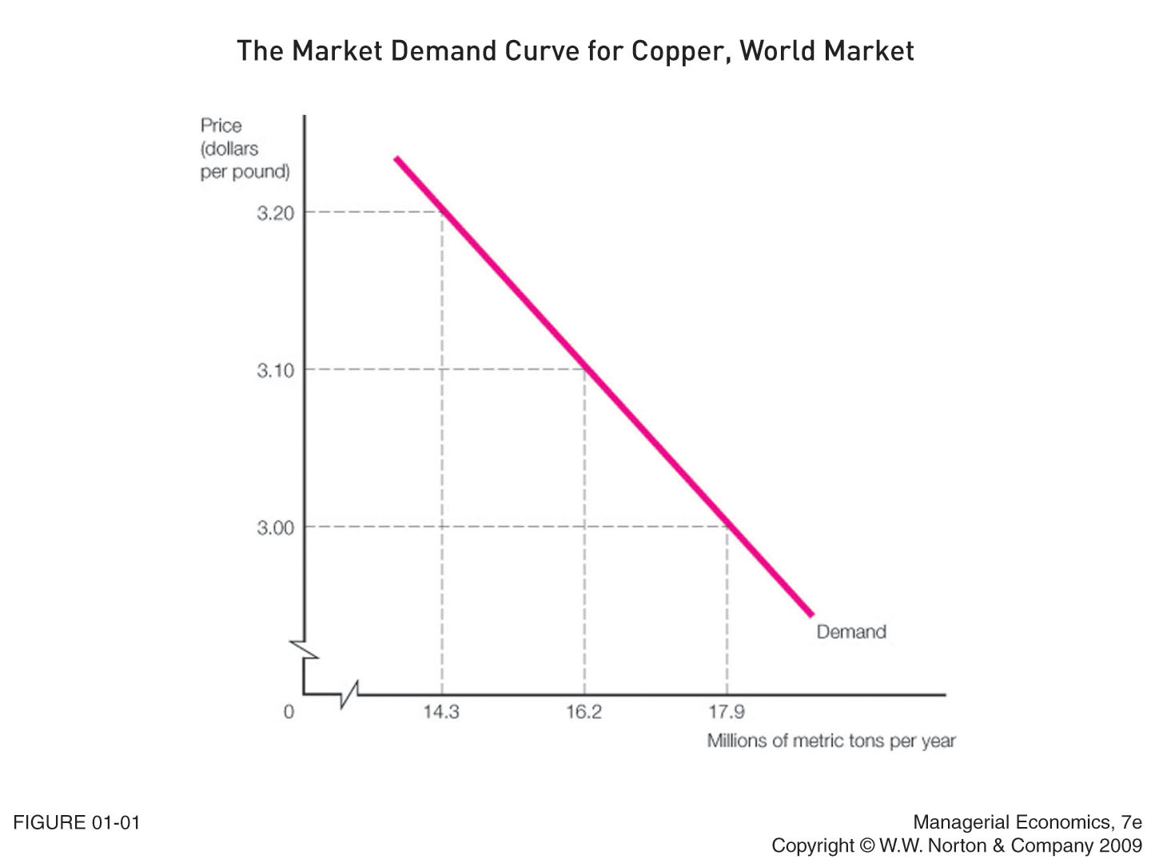
Notes:
Figure 1.1 appears on p. 10 of the textbook.
The figure shows that about 16.2 million metric tons of copper are demanded annually if the price is $3.10 per pound; about 14.3 million metric tons are demanded if the price is $3.20 per pound; and about 17.9 million metric tons are demanded if the price is $3.00 per pound.
In practice, one estimates demand and supply functions using regression analysis.

Slide 49
The Supply Side of a Market
Supply Function
  Quantity supplied relative to price within a given period of time, holding other influences (e.g., technology, costs of so-called “factors” of production such as labor and capital) constant
  Positive slope; quantity supplied increases as price rises.

Slide 50
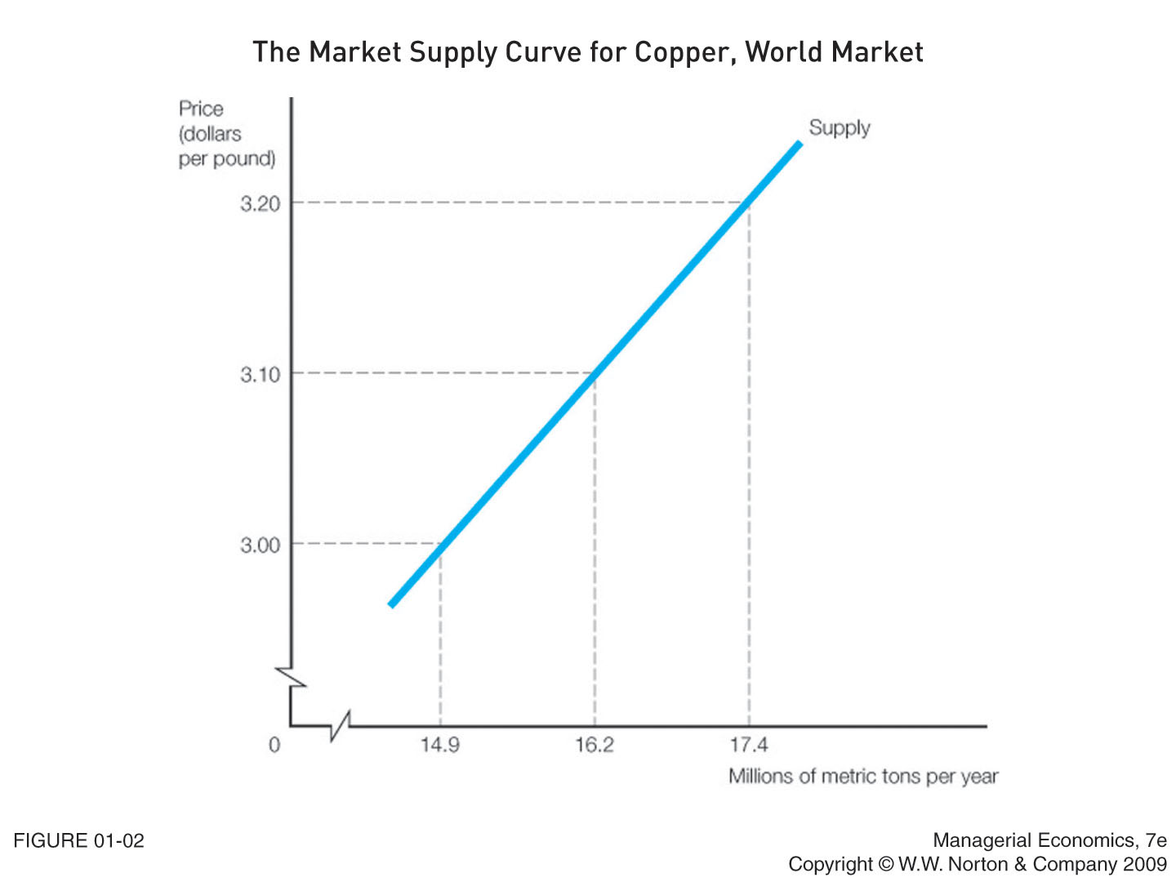
Notes:
Figure 1.2 appears on p. 12 of the textbook.
According to this figure, about 16.2 million metric tons of copper are supplied if the price of copper is $3.10 per pound, about 17.4 million tons if the price is $3.20 per pound, and about 14.9 million tons if the price is $3.00 per pound.

Slide 51
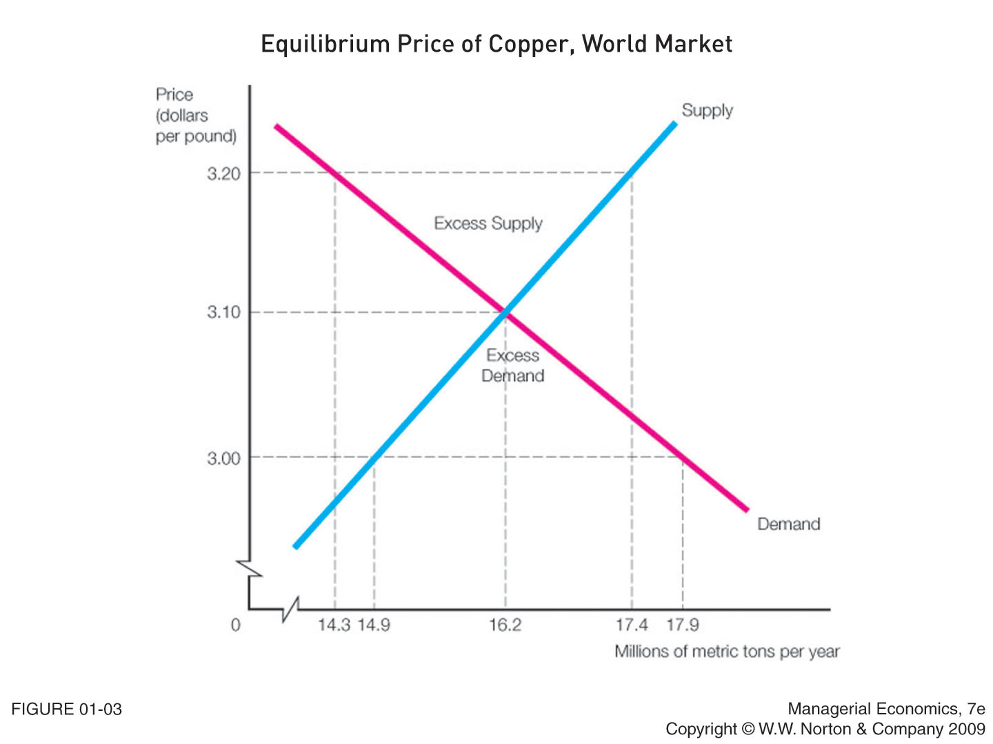
Notes:
Figure 1.3 appears on p. 13 of the textbook.
Now we can determine market behavior at various prices.
For example, if the price of copper is $3.20 per pound, the demand curve indicates that 14.3 million metric tons of copper are demanded, while the supply curve indicates that 17.4 million metric tons are supplied. Therefore, if the market price is $3.20 per pound, there is a mismatch between the quantity supplied and the quantity demanded. Because of this excess supply, producers will drop their prices, so $3.20 is not a sustainable market price.
If the price is $3.00 per pound, the demand curve indicates that 17.9 million metric tons are demanded, while the supply curve indicates that 14.9 million metric tons are supplied. So a market price of $3.00 also creates an imbalance in the market; there is not enough supply to satisfy demand. Because of this excess demand, producers will increase their prices, so $3.00 is not a sustainable market price.
An equilibrium price occurs when the quantity demanded at a price is equal to the quantity supplied at that price. The market is in balance because everyone who wants to purchase the good can, and every seller who wants to sell the good can. In Figure 1.3, the price at which the quantity supplied equals the quantity demanded is $3.10 per pound. This is also the point where the two curves intersect.
This is a good place to discuss the effect of minimum wage legislation (price floor – causes excess supply in the market for unskilled labor, which implies unemployment, and the effect of price ceilings say on gas prices – causes excess demand; rationing occurs, queues form, etc.

Slide 52
Actual Price
If actual price is above (below) equilibrium price, there will be a supply surplus (deficit) that puts downward (upward) pressure on the actual price.
If actual price is equal to equilibrium price, then there will be neither a shortage nor a surplus and price will be stable.
Notes:
I think that the important point here is that markets are very dynamic, and that actual market prices tend to converge over time toward so-called “equilibrium” prices. However, over short periods of time the actual price and equilibrium price can diverge.

Slide 53
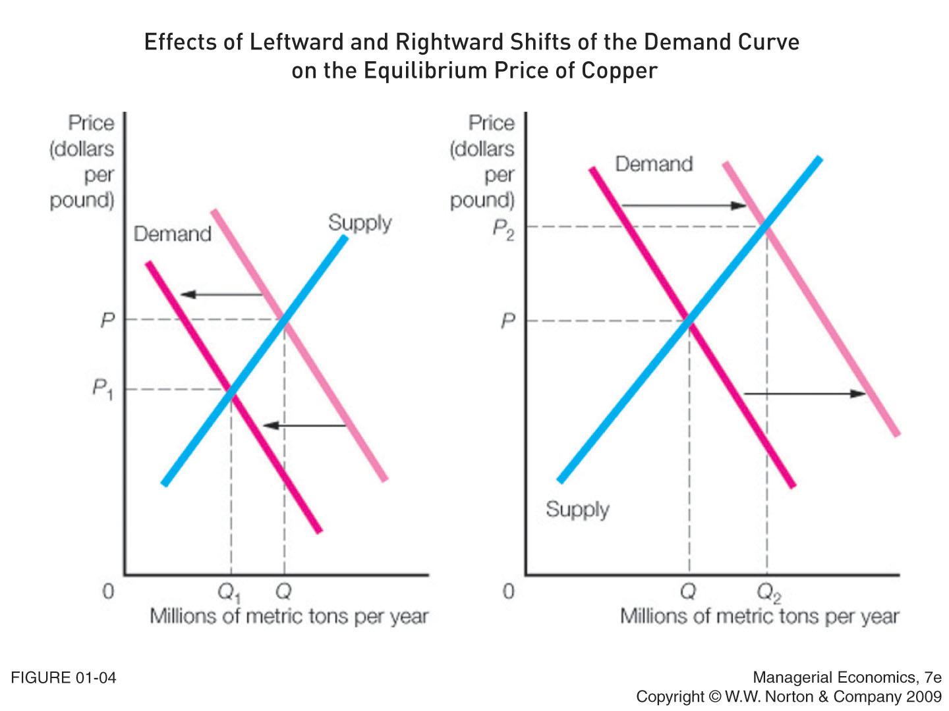
Notes:
Decrease in Demand
Represented by a leftward or downward shift in the demand curve.
Result of a change that makes buyers purchase a smaller quantity of a good at the current price and/or continue to buy the current quantity only if the price is reduced.
Will create a surplus and cause the equilibrium price to decrease.
Increase in Demand
Represented by a rightward or upward shift in the demand curve.
Result of a change that makes buyers willing to purchase a larger quantity of a good at the current price and/or to pay a higher price for the current quantity.
Will create a shortage and cause the equilibrium price to increase.

Slide 54
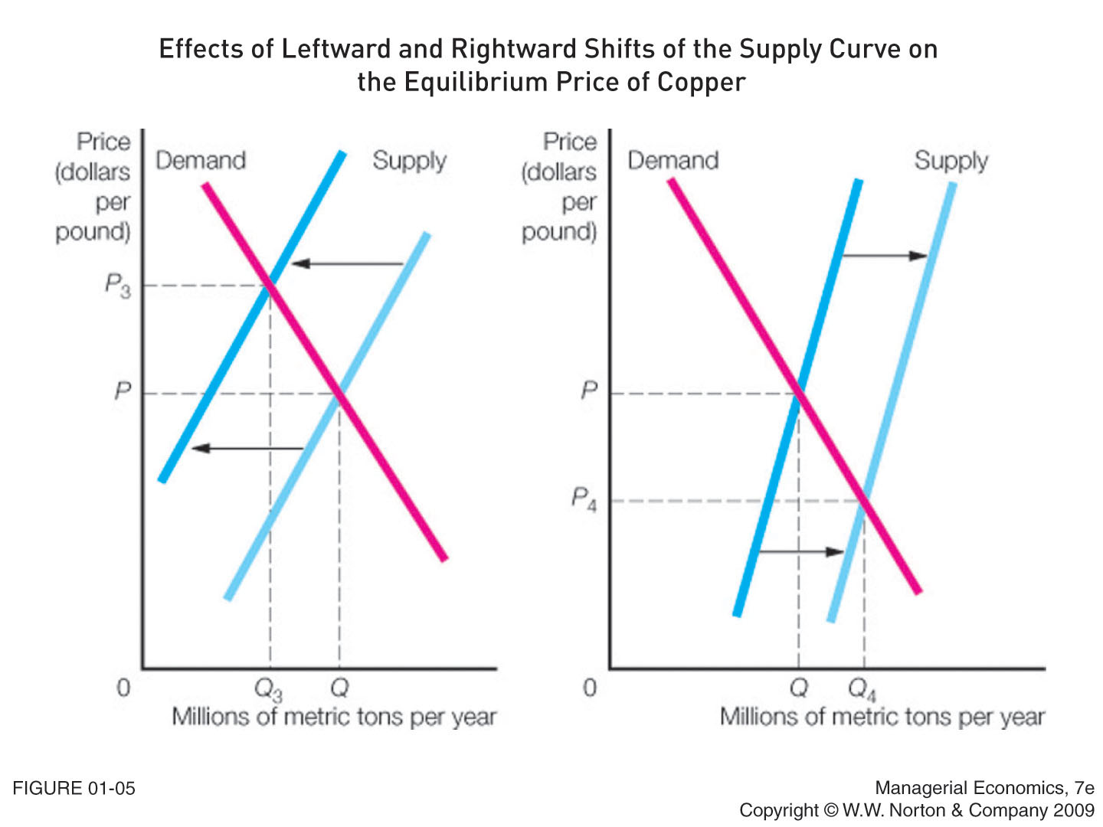
Notes:
Decrease in Supply
Represented by a leftward or upward shift in the supply curve
Result of a change that makes sellers willing to offer a smaller quantity of a good at the current price and/or to offer the current quantity at a higher price
Will create a shortage and cause the equilibrium price to increase
Increase in Supply
Represented by a rightward or downward shift in the supply curve
Result of a change that makes sellers willing to offer a larger quantity of a good at the current price and/or to offer the current quantity at a lower price
Will create a surplus and cause the equilibrium price to decrease

